Slide 1
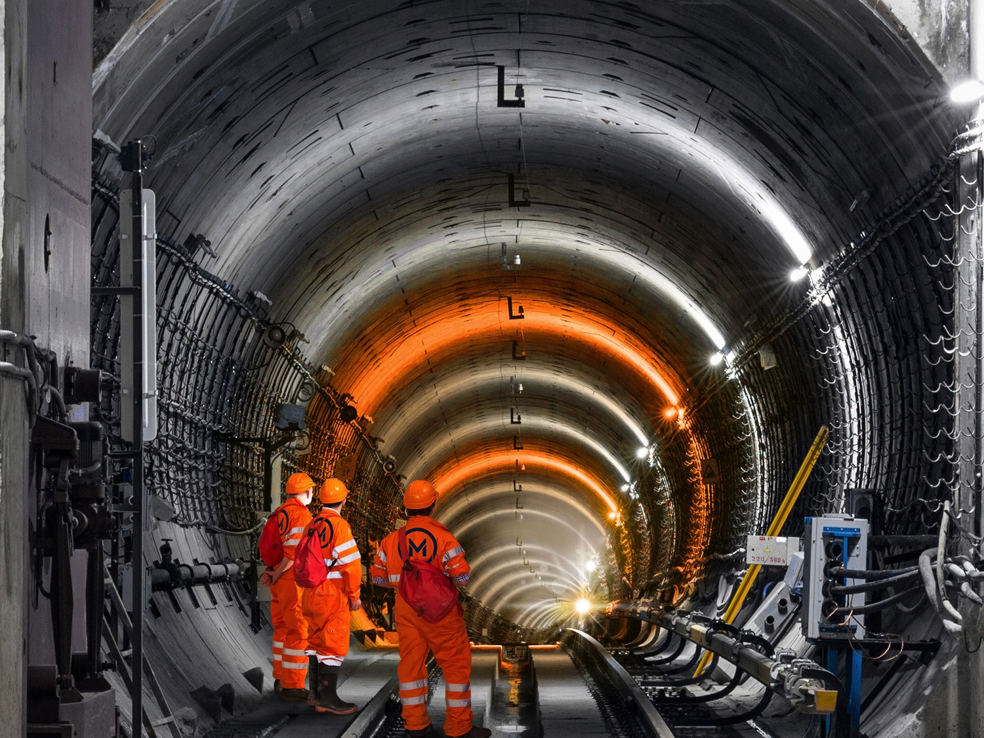



Project
22nd March 2018

Slide 2
National Development Plan 2017 - 2027
Key Public Transport Projects
BusConnects
DART Expansion
Metrolink
Cycling

Slide 3

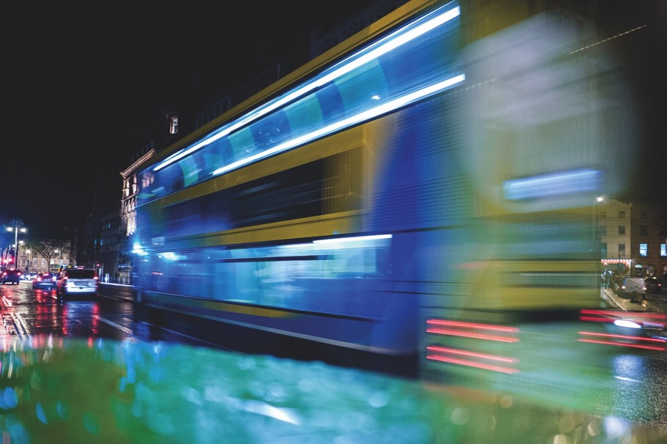
BusConnects Dublin

Slide 4
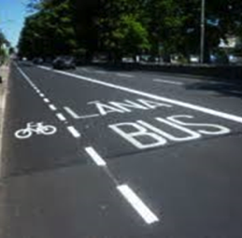
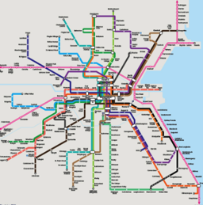
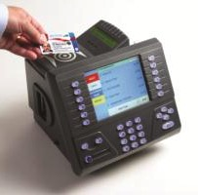
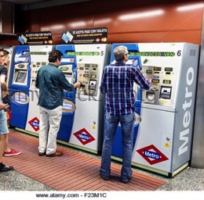

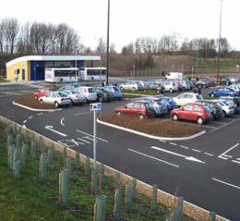
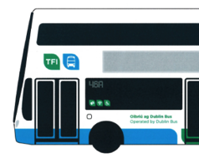
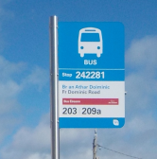

BusConnects: What is it?
A Network of “Next Generation” Bus Corridors
Complete Redesign of Bus Network
State-of-the-art Ticketing System
Simpler Fare Structure
Cashless Payment System
Park & Ride facilities
New Bus Livery
New Bus Stops
+ Shelters
Use of Low Emission Vehicles

Slide 5
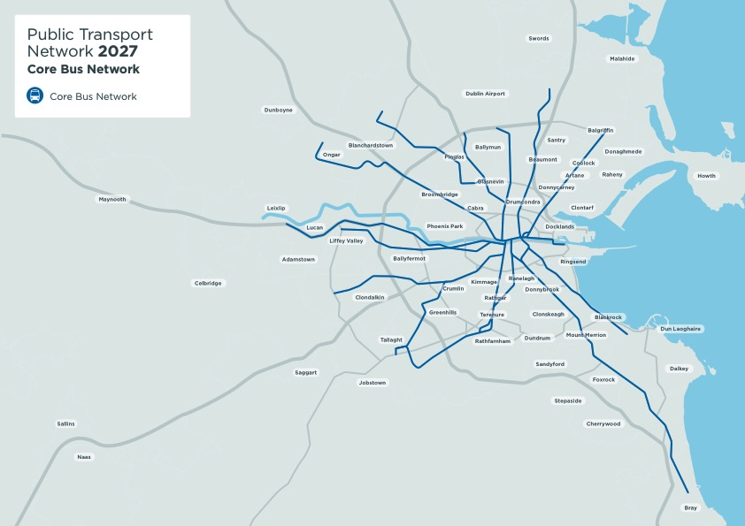

Slide 6

DART Expansion

Slide 7
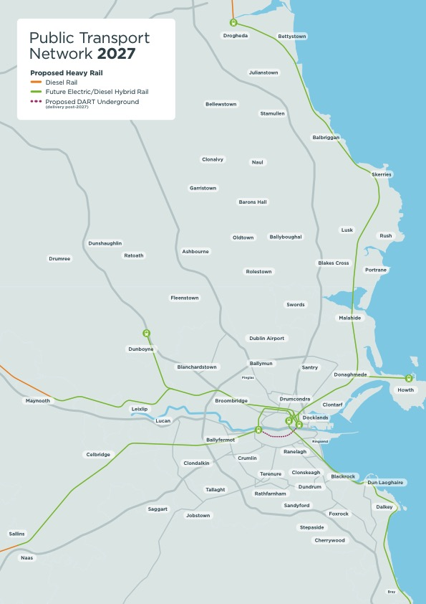

Slide 8
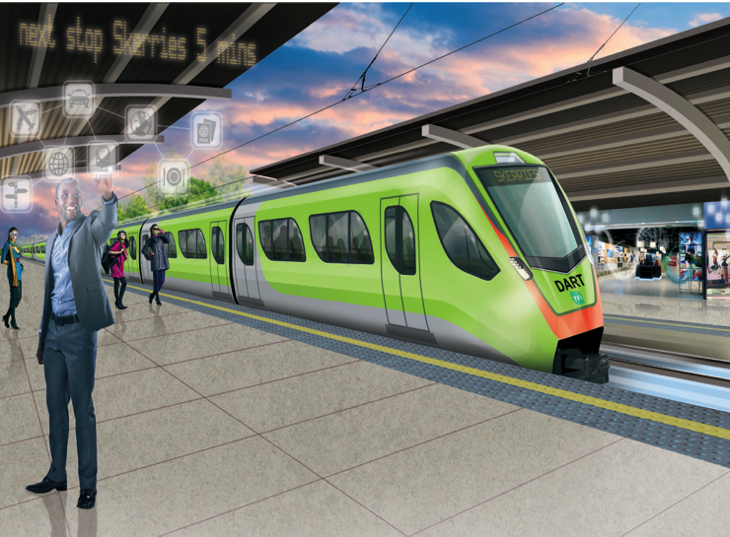
DART Expansion
Under the National Development we are prioritising investment in the non-tunnel elements of the DART programme
This will enable additional services to be put in place much earlier, using existing infrastructure with some enhancements
We intend to purchase diesel electric train sets that can operate as electric powered or diesel powered
This will allow DART to be expanded initially without electrification
Electrification will follow to provide a more energy efficient rail network with lower carbon emissions

Slide 9
LUAS & Metro

Slide 10
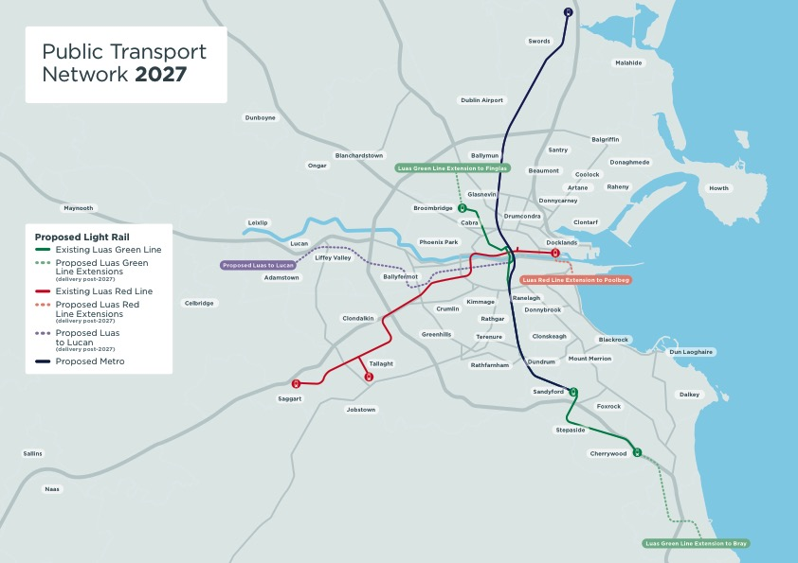

Slide 11
Rail Integration

Slide 12
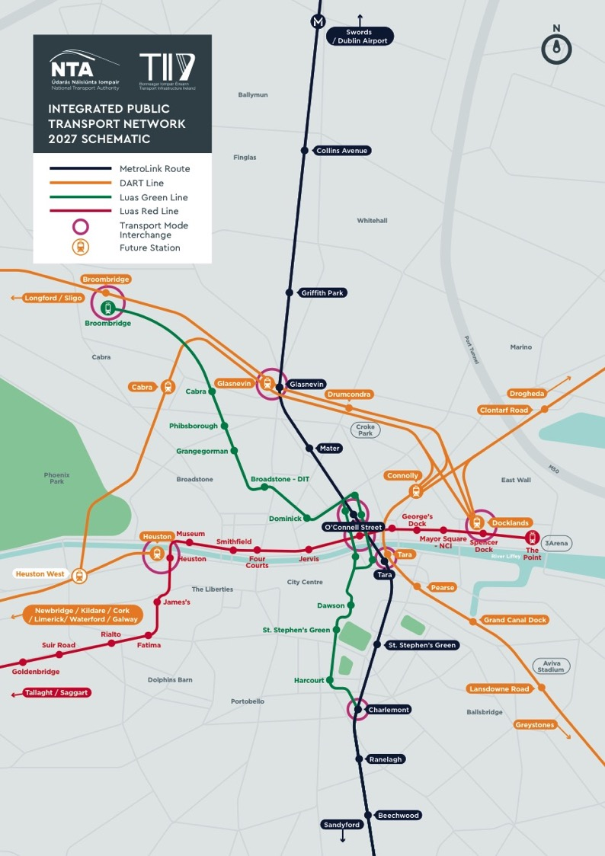

Slide 13
GDA Public Transport Network

Slide 14
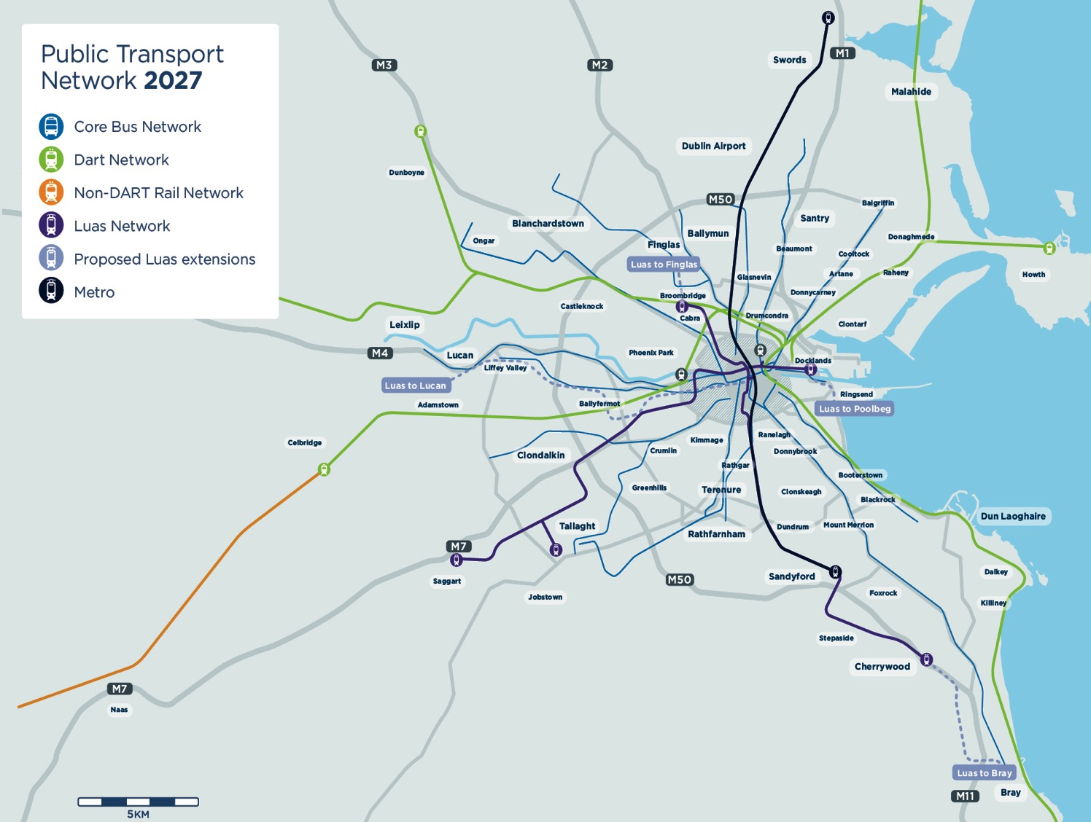

Slide 15

MetroLink Project
MetroLink

Slide 16
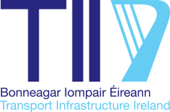
Overall Metro Scheme
MetroLink comprises the previous scheme known as Metro North, running between Swords and St. Stephen’s Green, and what has been referred to as Metro South, extending from St. Stephen’s Green to Sandyford
Delivers a full north-south high capacity spine from Swords to Sandyford by 2027

Slide 17
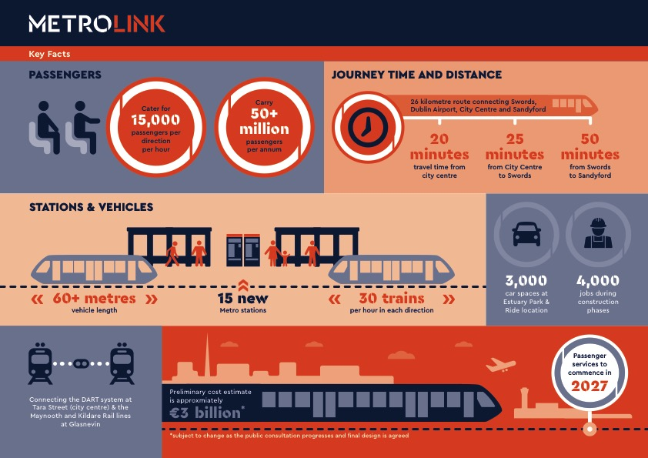

Slide 18
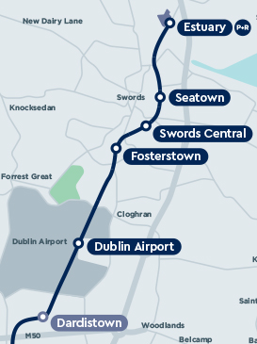
M50 to Swords
Key Points
3,000 space park and ride site proposed at north end of the scheme
Metro remains in bored tunnel until just south of Swords
Route remains on the R132 Swords Bypass but as an elevated metro running above the median

Slide 19
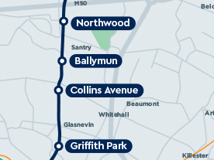
City Centre to M50 Section
Key Points
Optimum route is via Phibsborough with a station at Cross Guns Bridge – previous corridor was via Drumcondra Rail Station. This integrates better with the DART proposals and provides a very good interchange facility between two rail lines and metro
Metro is in bored tunnel all through this area

Slide 20
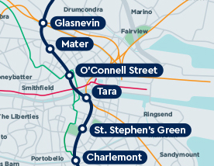
City Centre Section
Key Points
Avoids duplicating line of Luas Cross City
Doesn’t terminate at St. Stephen’s Green – connects to Green Line at Charlemont
Links to DART system at Tara Station
Core city centre stations are at St Stephen’s Green East, Tara Street and O’Connell Street
Avoids major interference with St. Stephen’s Green

Slide 21
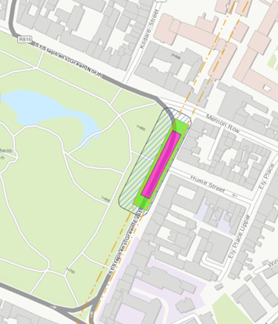
Changes from the original
Metro North
Connects to the Green Line from day 1
Connects to the DART system at Tara Street and at Glasnevin (Cross Guns Bridge) from day 1 providing an integrated rail system
Doesn’t duplicate the Luas Cross City line
Avoids the major interference with St. Stephen’s Green by placing a simplified station under the roadway on St. Stephen’s Green East
Removes the complex station previously planned for O’Connell Bridge, which had major construction impacts
Routes through Phibsborough rather than Drumcondra due to the better interchange capability with the heavy rail system at Glasnevin Station
Severs the Green Line at Charlemont, with southbound Luas services from Broombridge terminating at Charlemont, but with an easy interchange to Metro
The line south of Sandyford is likely to operate as a separate Luas line, but the final decision on this will be taken at a later stage
St. Stephen’s Green East Station. Pink is station box. Hatched area is area for construction but can be reduced on park side. (Tunnel not shown but runs north-south through the pink box.

Slide 22
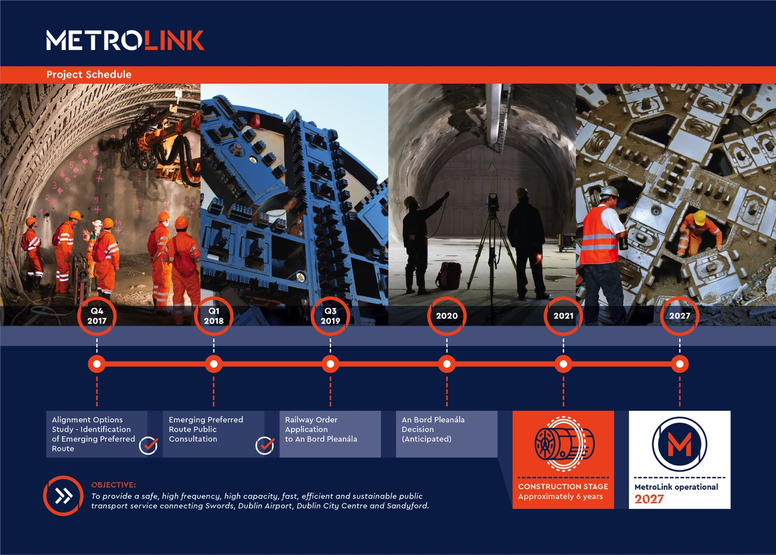

Slide 23
Next Steps
Public consultation on the Emerging Preferred Route (EPR) will continue until 11th May 2018
In addition to a series of public information events along the route, TII are available to meet with stakeholders and interested parties over the coming weeks and months
It is hugely important for TII to engage at the earliest opportunity with the public
The Emerging Preferred Route will be reviewed and amended where necessary based on public consultation feedback and insights
Railway Order application will be submitted Q3 2019
Date | Venue | Times
Tuesday 27/03/2018 | Fingal County Council offices, Swords | 14.00 – 20.00
Thursday 29/03/2018 | Crowne Plaza Hotel, Northwood, Santry | 14.00 – 20.00
Wednesday 04/04/2018 | Wood Quay Venue at Dublin City Council Offices | 14.00 – 20.00
Thursday 05/04/2018 | Glasnevin Museum Trust | 14.00 – 20.00
Monday 09/04/2018 | The Helix, Collins Avenue, Dublin 8 | 14.00 – 20.00
Monday 16/04/2018 | Hilton Hotel, Charlemont, Dublin 6 | 14.00 – 20.00
Wednesday 18/04/2018 | Clayton Hotel, Leopardstown, Dublin 18 | 14.00 – 20.00

