Slide 1
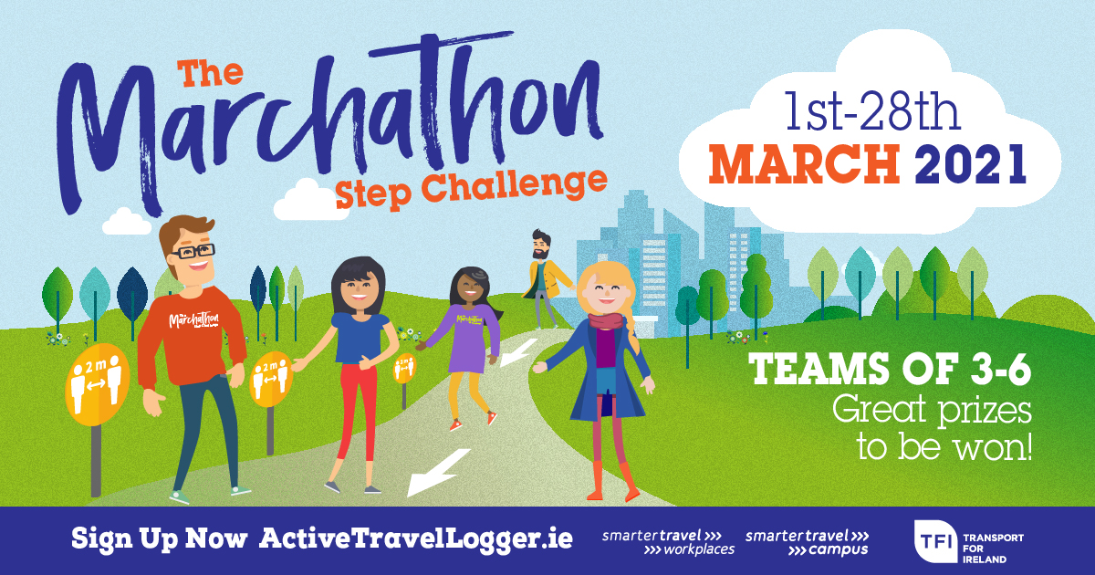
[Insert Organisation Name]’s Marchathon Step Challenge

Slide 2
The Marchathon Step Challenge 1st March – 29th March 2021
[Include information relevant to your organisation on this slide to encourage staff and/or students to sign up and take part]
Marchathon is a fun, free & team building annual event to encourage you to take more daily steps and increase your activity levels.
Drive less, sit less & step more! Can you go the extra step?
Create/Join a team of 3-6 people on www.activetravellogger.ie
Log your daily steps on the Active Travel Logger (video tutorials provided)
Compete against other teams in [insert organisation] and around the country to make it to the top of the Leaderboard.
Take part in the weekly competitions and win some great prizes!
Sign-up now: www.ActiveTravelLogger.ie
For more information: www.Marchathon.ie

