Slide 1
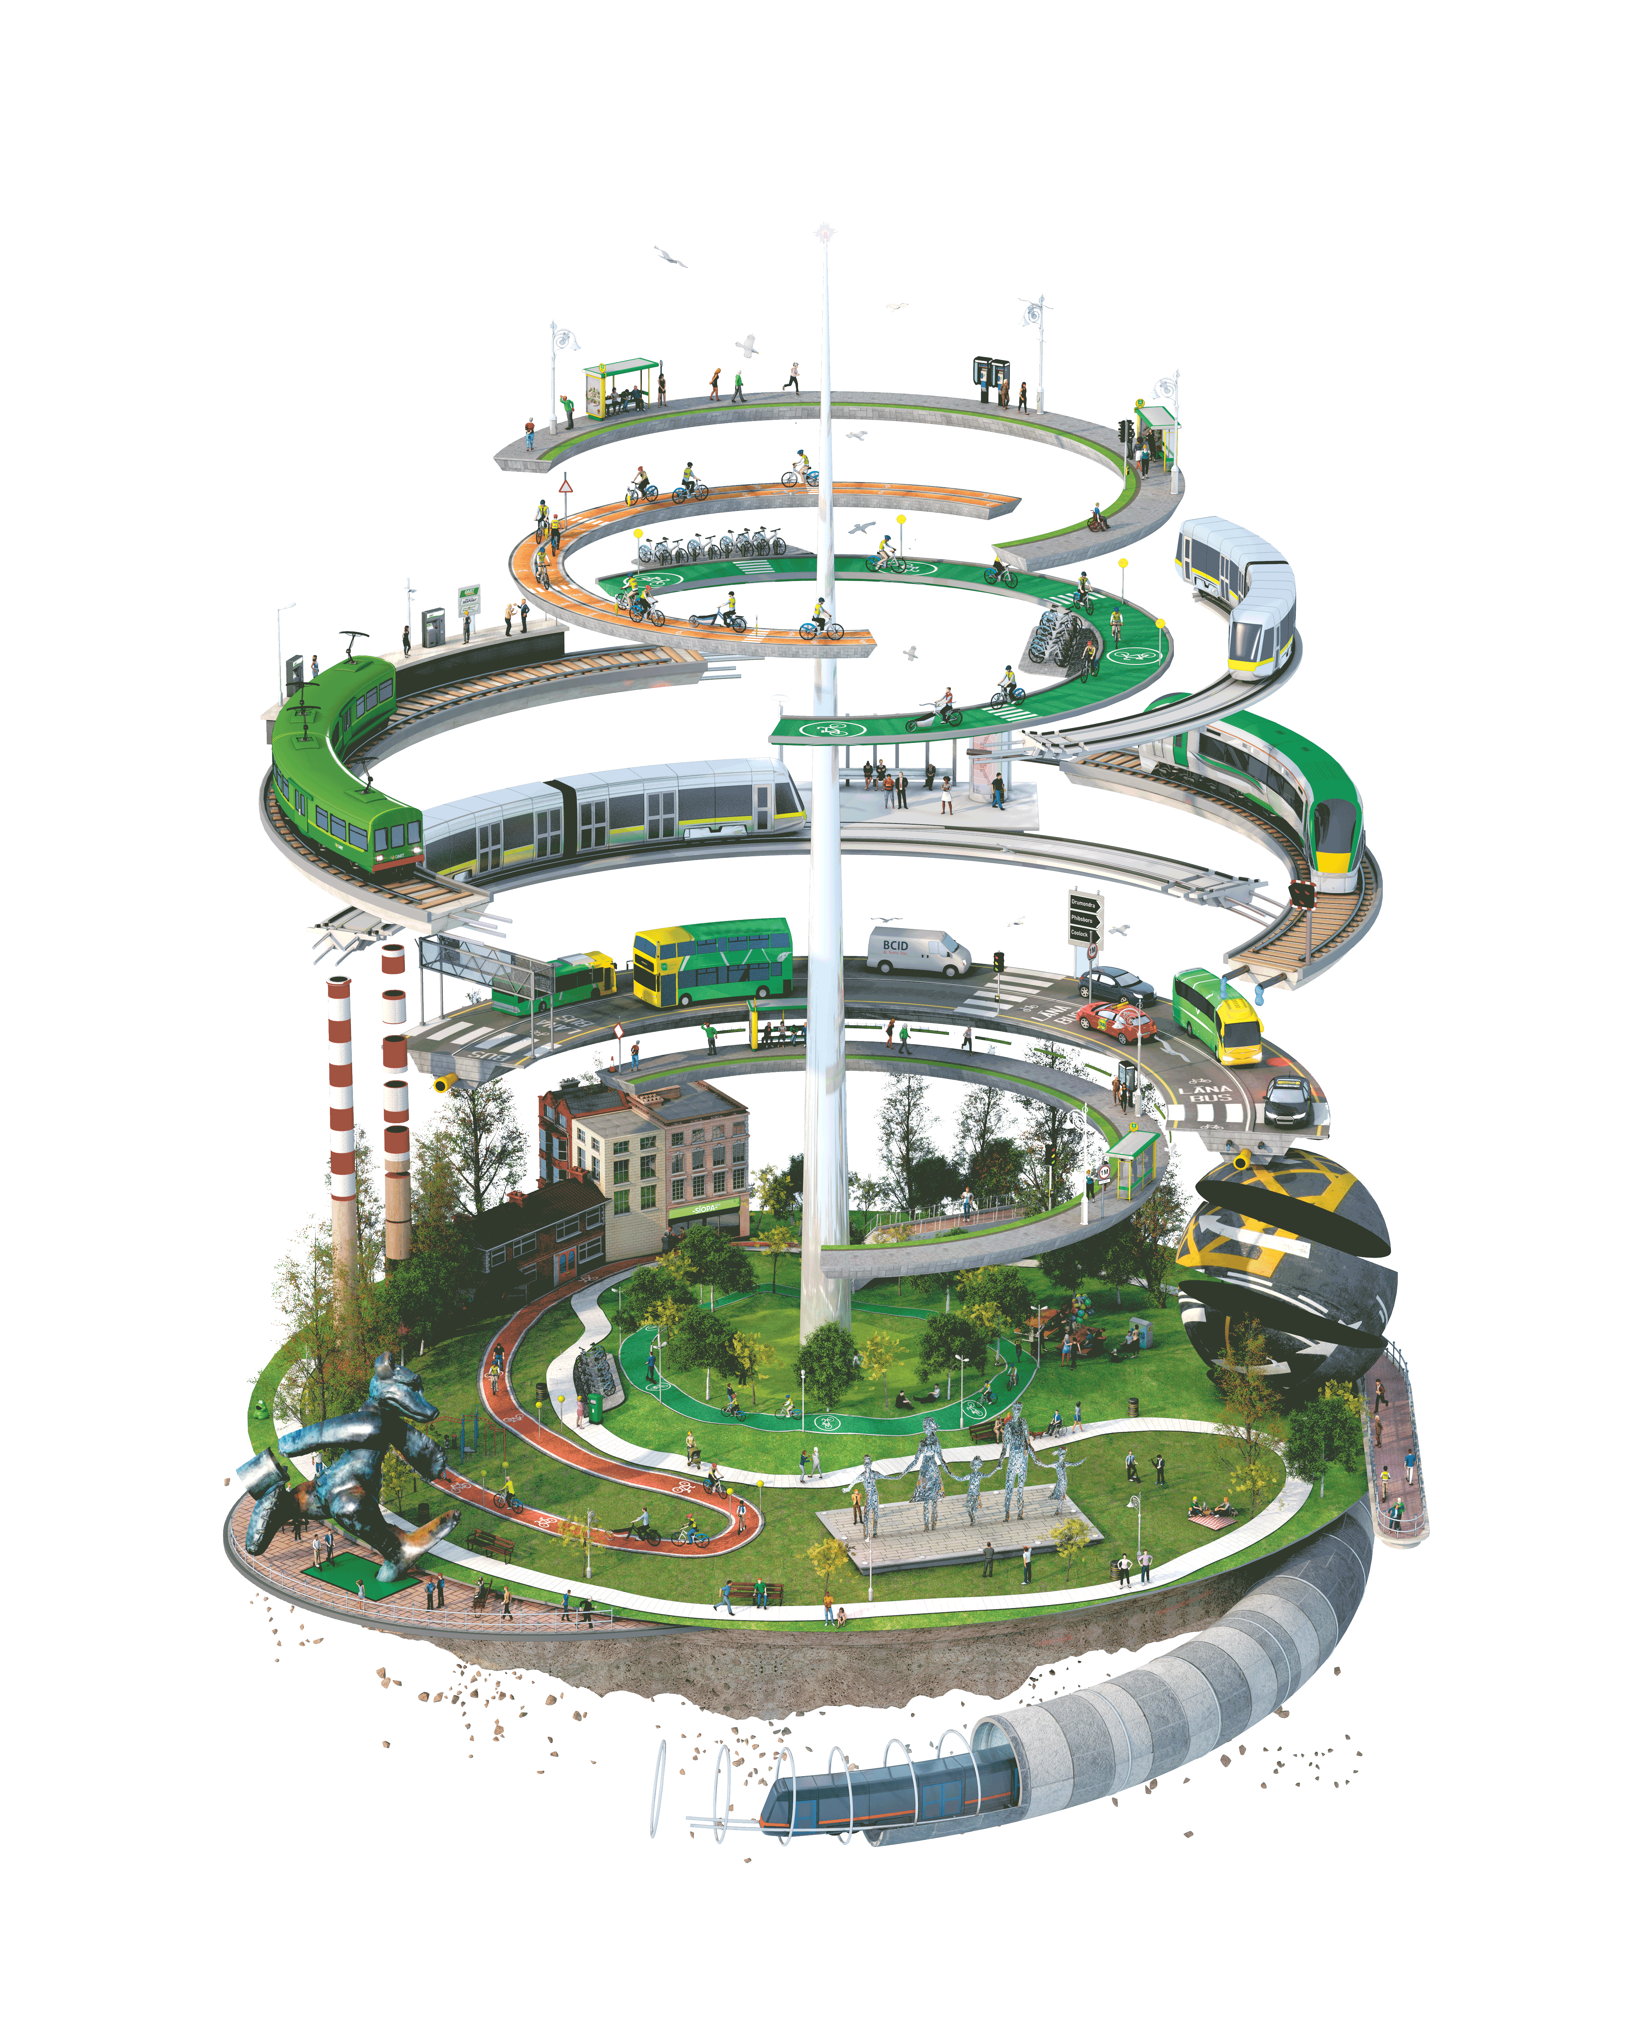
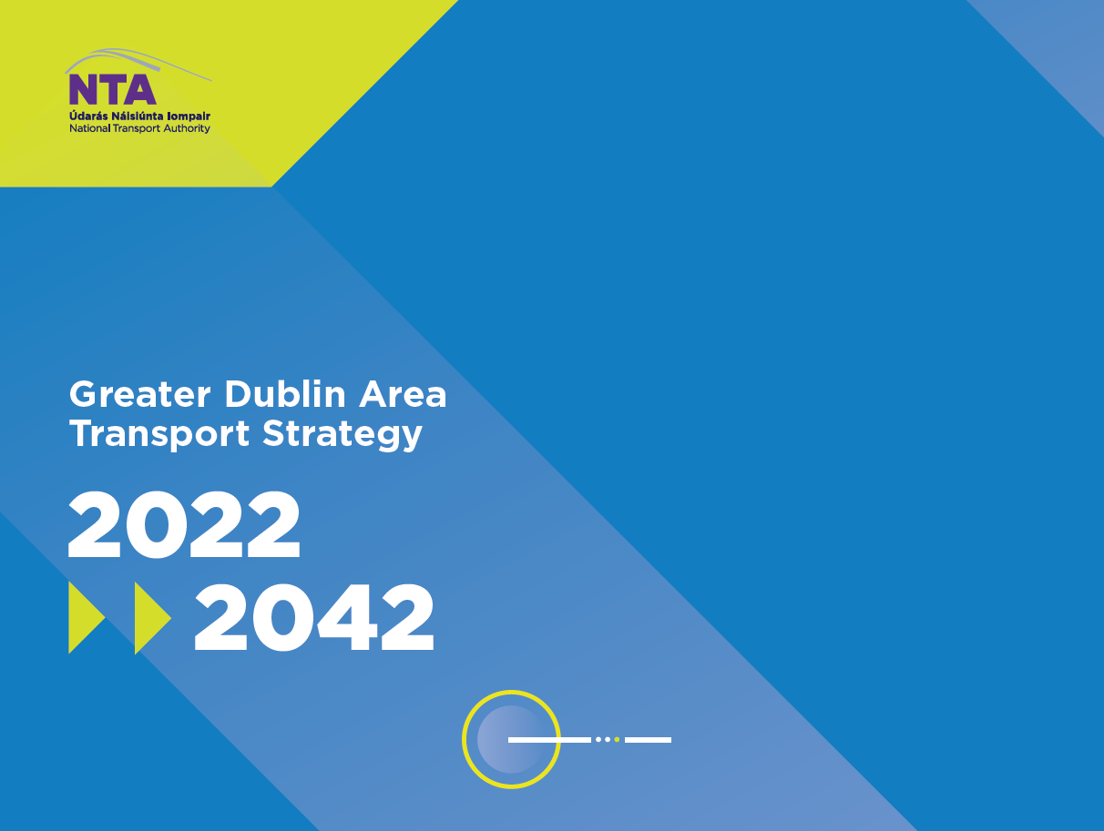

Slide 2


Hugh Creegan,
Deputy Chief Executive Officer,
National Transport Authority

Slide 3
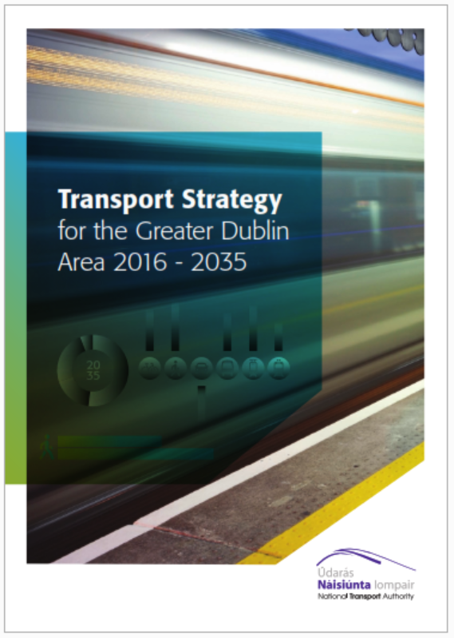
Current Transport Strategy
The current Transport Strategy for the Greater Dublin Area 2016-2035 was adopted in 2016, setting the framework for the development of transport for the next two decades
Under that strategy, major transport changes have been advanced, including:
Luas Cross City has been completed
Phoenix Park Tunnel rail link was re-opened to passenger services
BusConnects Dublin has commenced with the first phase of the new network now operational, the next phase to be introduced later this month and Core Bus Corridors ready to be submitted for planning consent in the coming months
A preferred route has been identified for MetroLink and it is ready to be summited for planning consent next year
Major increases have been delivered in cycling infrastructure and a programme for its continued roll-out is now in place
A large investment in bus fleet focused on low emission vehicles and now transitioning to fully zero emission fleet

Slide 4
Review and Update of Strategy
Under the relevant legislation the NTA is required to undertake a review of its transport strategy every six years
We commenced that review with a consultation process that concluded in January, seeking feedback from the public to frame the development of the new strategy.
We received approximately 4,000 submissions, with many items identified for consideration, but with an overwhelming 90% of respondents answering yes to the question: “Do you think the strategy should seek to reduce the reliance on private car for travel?”
Taking account of that feedback we undertook various studies and analyses, and have developed a draft updated transport strategy to take us up to 2042
It takes account of our climate change requirements, the need to move more people to sustainable transport and the changed transport patterns that are likely to arise from Covid
We are now publishing that draft strategy for public review and feedback

Slide 5
David Clements
Transport Planner
National Transport Authority

Slide 6
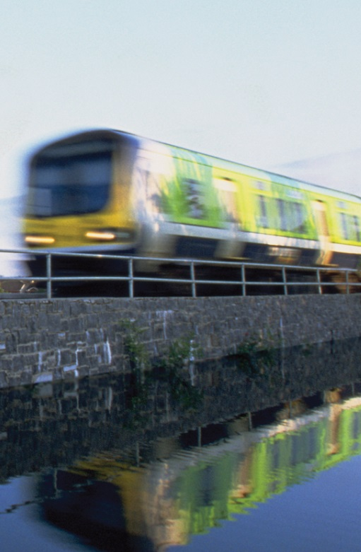
Aim and Objectives
The overall aim of the Transport Strategy is:
“To provide a sustainable, accessible and effective transport system for the Greater Dublin Area which meets the region’s climate change requirements, serves the needs of urban and rural communities, and supports economic growth.”
Four objectives have been developed to support the delivery of the overall aim of the Transport Strategy, focussing on:

Slide 7
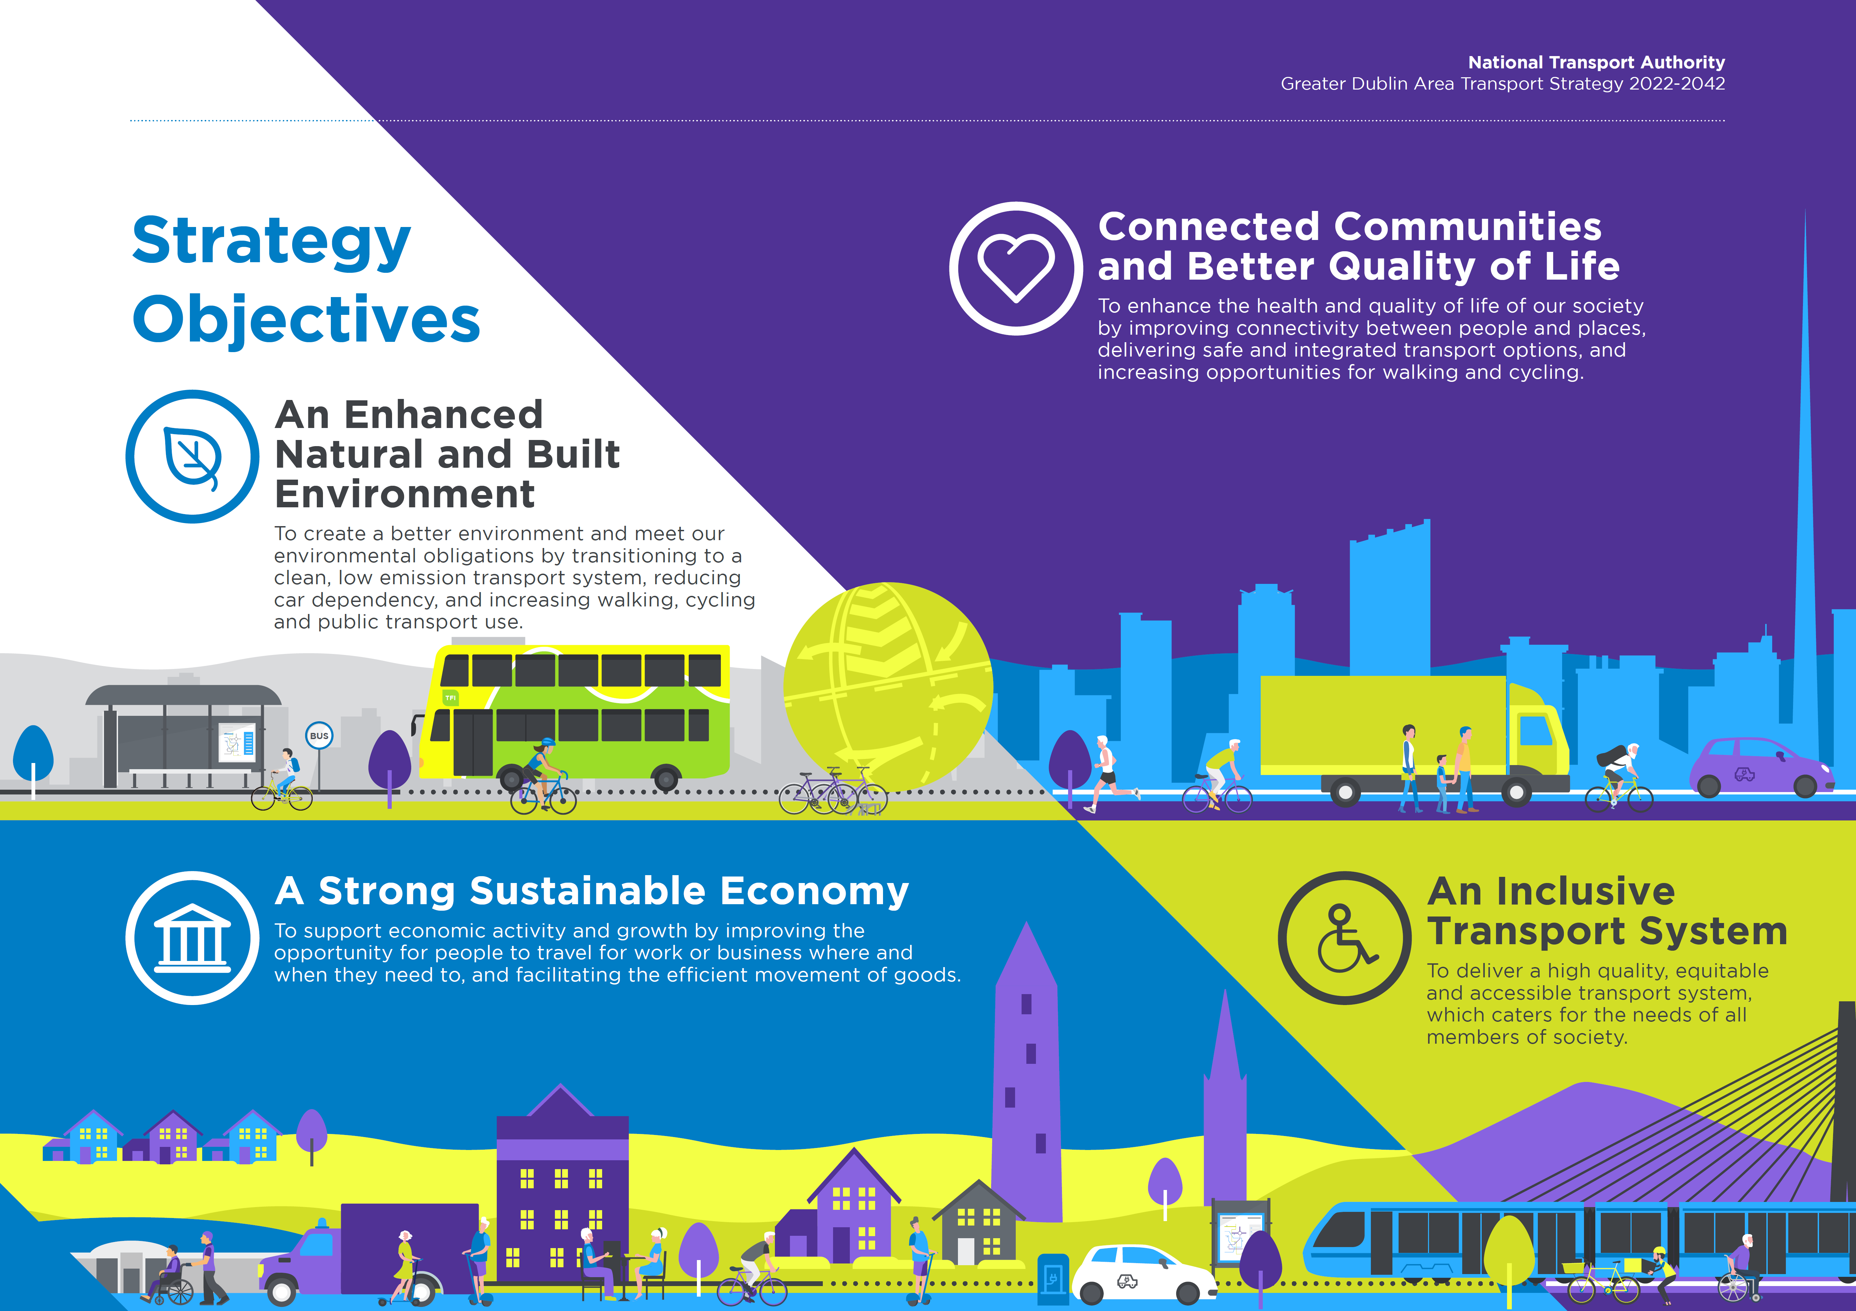

Slide 8
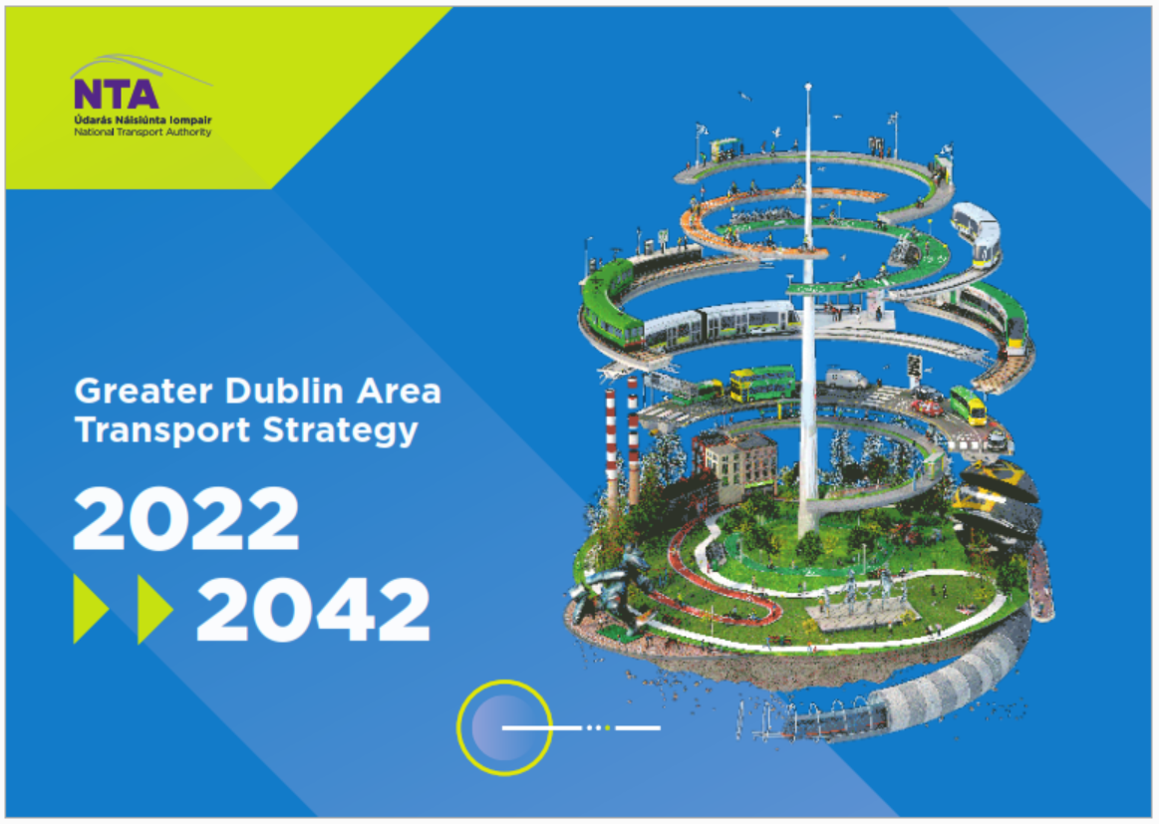
What’s in the Strategy
The Draft Transport Strategy seeks to address all aspects of land-based transport within the Greater Dublin Area and sets out a variety of actions covering:
Planning for Sustainable Transport
Integration and Inclusion
Walking, Accessibility and Public Realm
Cycling and Personal Mobility Vehicles
Public Transport – Bus, Luas, Metro and Heavy Rail
Roads
Traffic Management and Travel Options
Freight, Delivery and Servicing
Climate Action Management

Slide 9
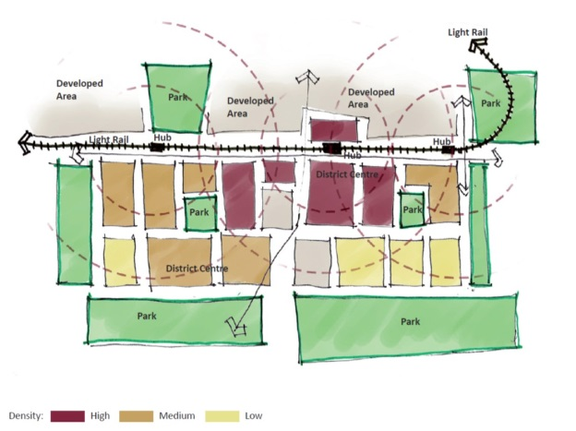
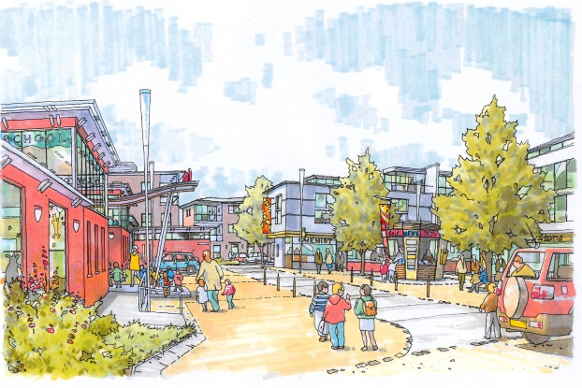
Planning for Sustainable Transport
The management of transport demand where it is created is a critical element of transport planning in the GDA. The pattern of where people live, work, attend school or college, and socialise is therefore the key determinant in the type of transport system that is required
The Draft Transport Strategy includes measures that are considered to be essential in meeting the high level objectives of fostering sustainable development and fully integrating land use planning and transport planning, including the following:
Consolidation of development
Transit-oriented development
Mixed use development
Filtered Permeability
School Planning and Design

Slide 10
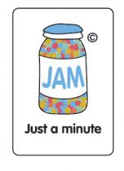

Integration and Inclusion
The Transport Strategy includes a range of measures that have been developed in support of the overarching objective of an integrated transport system, including 20 measures covering the following areas:
  Integration of all Modes in Transport Schemes
  International Gateways
  Park & Ride provision
  Major Interchanges and Mobility Hubs
  General Interchange
  Revised Fare Structure
  Next Generation Ticketing
  Mobility as a Service
  Smarter Travel Workplaces and Campuses
  Green Schools Travel
  Residential Travel Planning
  Late Night Transport
  Small Public Service Vehicles
  Walking and Cycling at Night
  Accessible Infrastructure
  Travel Information
  Travel Assistance Scheme
  Equality and Inclusivity
  Equality Assessment
  Enforcement of Road Traffic Laws

Slide 11

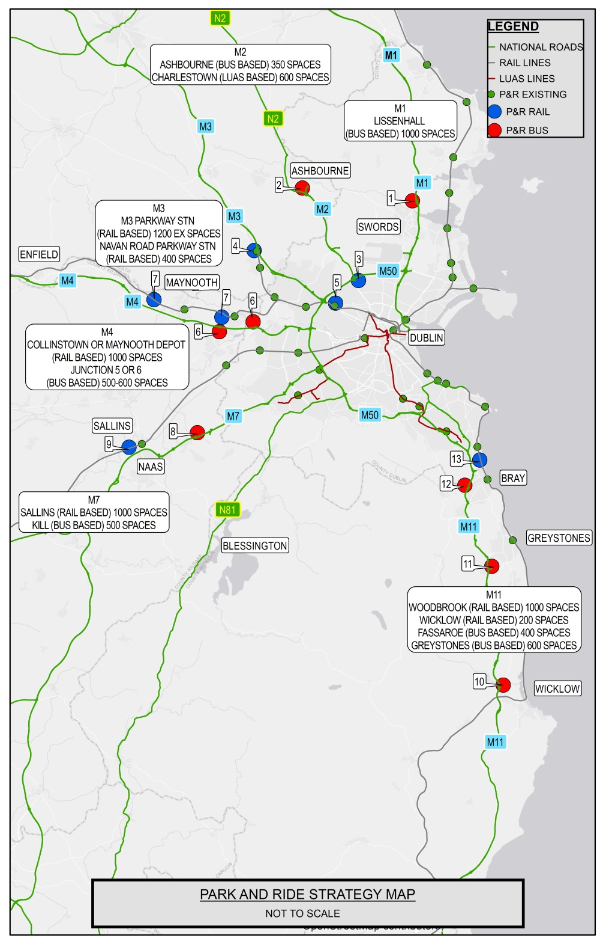

Slide 12
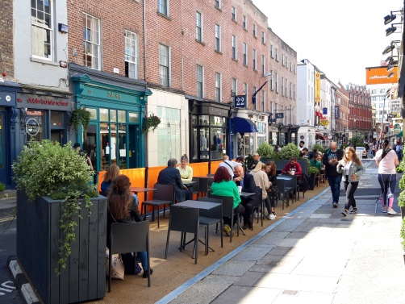
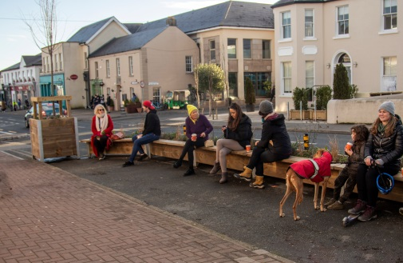
Walking, Accessibility and Public Realm
Eight measures are set out including the following actions:
Ensuring that all urban areas will be served by high quality pedestrian facilities through the implementation of footpath improvement schemes, the development of suitable maintenance programmes and the delivery of new footpaths where required
A programme of junction revisions including the removal of slip lanes, tighter turning radii to slow vehicles, provision of additional pedestrian crossing points, and changes to traffic signals
Support for wayfinding systems and their integration into journey planning apps
Provision of traffic free streets in town centres where there are benefits to transport and/or the local environment / economy
Ensuring that the needs of all pedestrians, including persons with disabilities, wheelchair users and people with buggies, are met

Slide 13
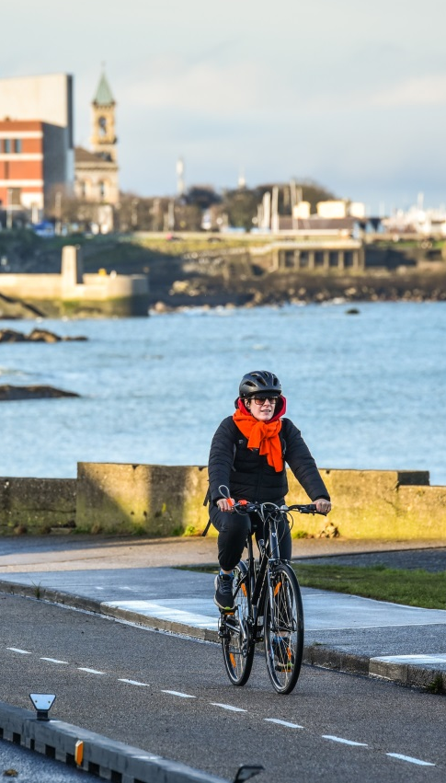
Cycling and Personal Mobility
The Covid pandemic has induced a major growth in the numbers of people cycling both here and internationally. The Draft Strategy seeks to build upon that resurgence and provide safe, quality infrastructure and facilities that enables more people to adopt cycling as a travel mode for short journeys
Network Planning, Infrastructure Design, Cycle Parking and Bike Share Schemes are all key elements of a comprehensive, inclusive, cycle-friendly environment and 11 proposed measures are set out.
GDA Cycle Network Plan
Cycle Infrastructure Design
Cycle Parking
Cycle Parking Strategies
Bike Share Scheme Expansion
Bike Share Scheme Electrification
Interoperability between Bike Schemes
Bikes on Public Transport
E-Bikes
Electric Scooters
Other Emerging Personal Mobility Modes

Slide 14
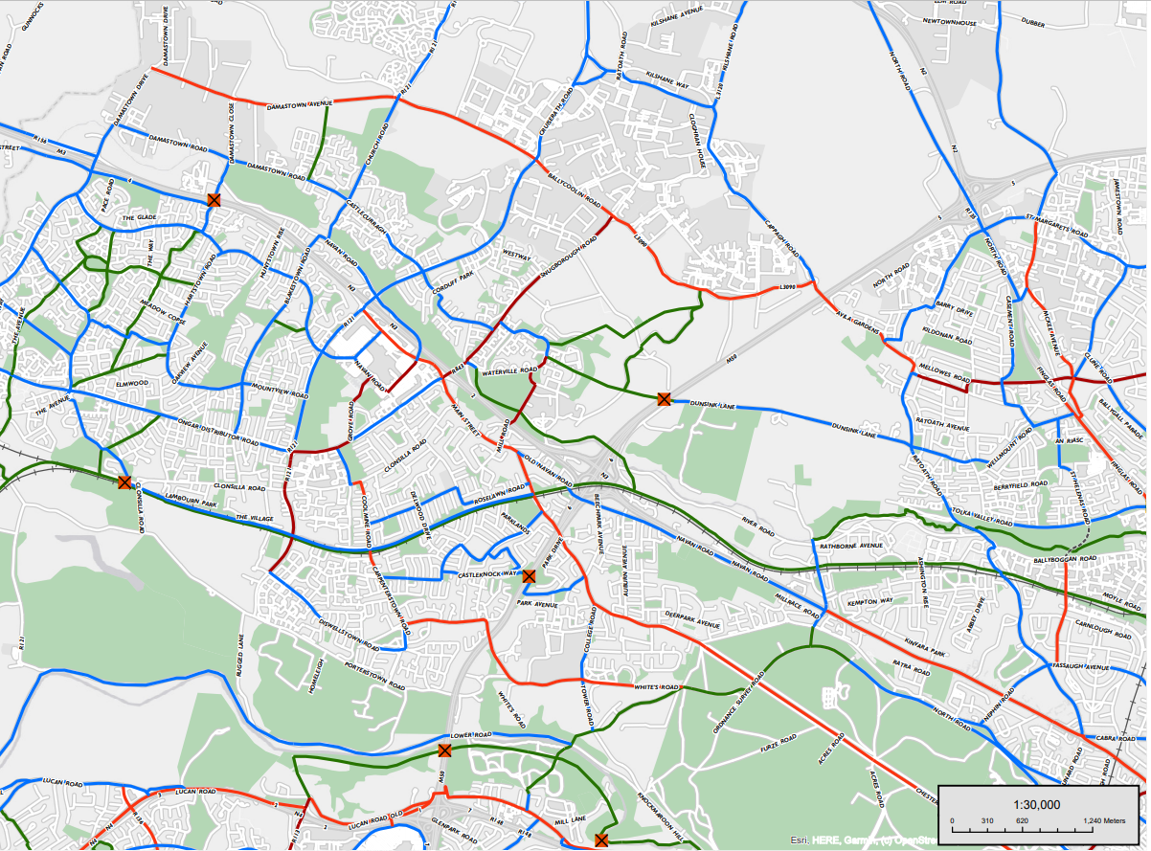

Slide 15
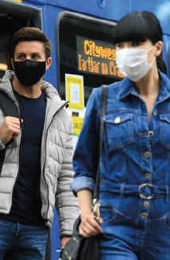
Public Transport - Bus
The Dublin Area Bus Network carries the highest proportion of public transport trips in the GDA and will continue to do so for the lifetime of the Transport Strategy. To support this key mode, the strategy proposes a wide range of measures, including:
BusConnects Core Bus Corridor Programme
Additional Radial Core Bus Corridors
Orbital Core Bus Corridors
New Dublin Area Bus Service Network
Bus Service Network Monitoring and Review
Higher Capacity Bus Fleet
Zero Emissions Bus Fleet
Regional and Intercity Coach Fleet
Bus Livery
New Bus Stops and Shelters
Regional Core Bus Corridors
Bus Priority in Towns and Villages
Connecting Ireland
Regional and Rural Bus Services
Local Link and Demand Responsive Transport

Slide 16
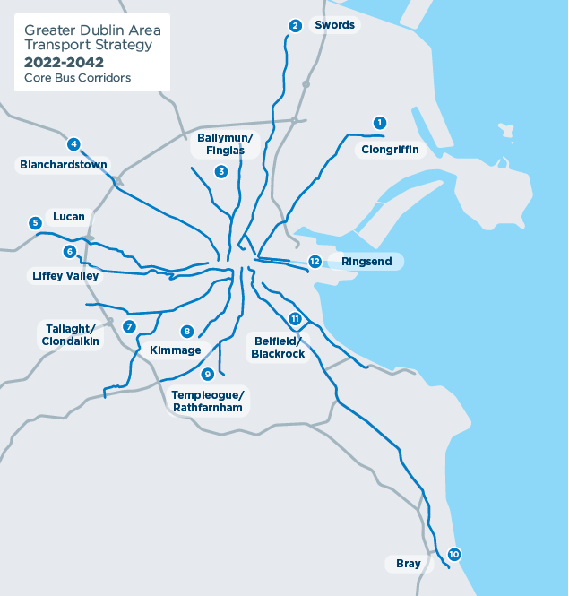
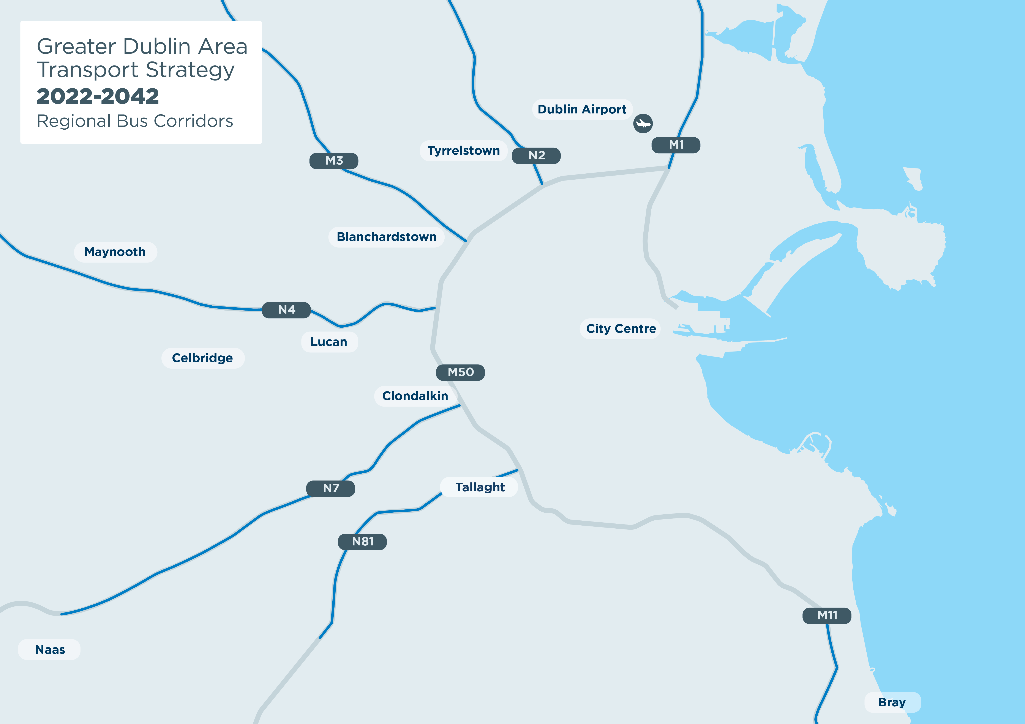
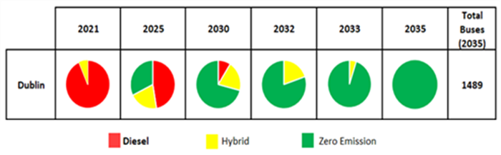

Slide 17
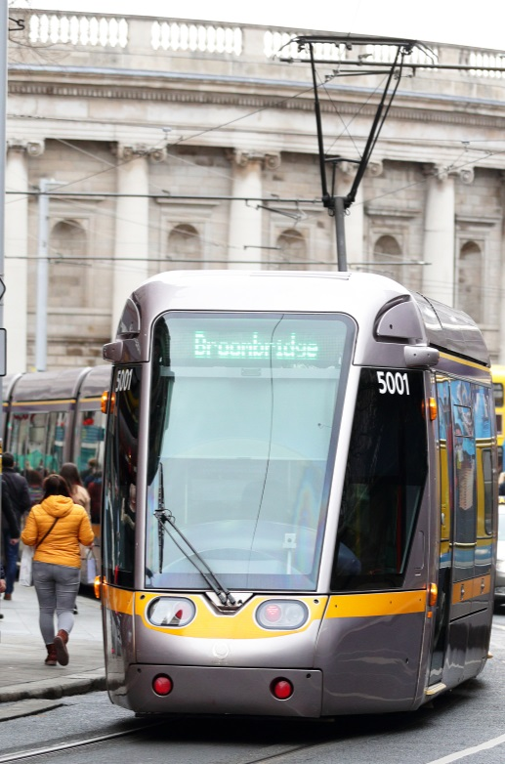
Public Transport - Light Rail
The Draft Transport Strategy includes for the delivery of MetroLink (planning consent to be sought in 2022) and four Luas extensions /new lines:
Extension to Finglas
Extension to Bray
Extension to Poolbeg
A light rail line from Lucan to the City Centre, supplementing and complementing the planned bus system
In addition, the Draft Transport Strategy proposes the planning and design of a further 8 Luas extensions/ new Luas lines to be ready for construction post 2042:
Luas to Clongriffin
Luas to Balgriffin
Luas extension to Tyrrelstown
Luas to Blanchardstown
Luas extension to Clondalkin
Luas to Tallaght / Kimmage
Luas to Tallaght / Knocklyon
Luas to UCD / Sandyford (reduces future passenger congestion on the Green Line in the future)

Slide 18
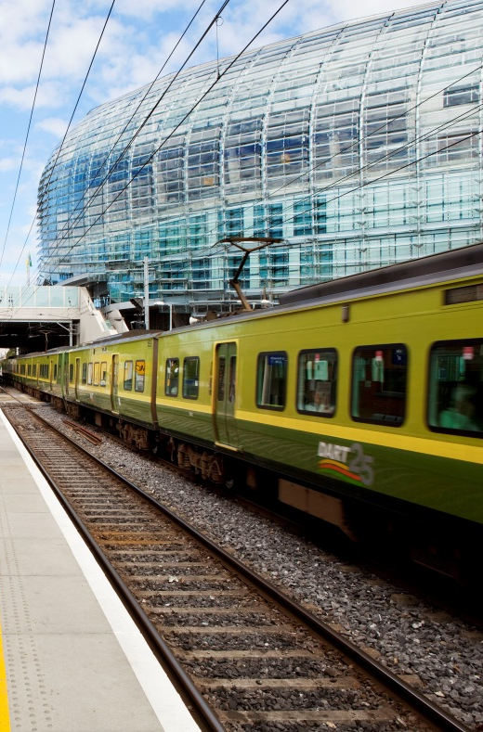
DART+ and Rail
The spine of the Dublin transport system has historically been provided by the heavy rail network, in particular by the east coast suburban line since its electrification in 1984. Building on that legacy the Draft Transport Strategy provides for:
Delivery of the DART+ Programme – DART to Drogheda, Maynooth & Celbridge, plus enhanced service to Greystones
Further extensions of DART to Kilcock, Naas/Sallins and Wicklow
Provision of a new rail line from the M3 Parkway to Navan
New stations at Cabra, Glasnevin, Heuston West, Kylemore, Woodbrook, west of Sallins, west of Louisa Bridge and west of Maynooth plus opening of Kishoge station
Completion of the National Train Control Centre
DART+ Tunnel - preserve and protect an alignment to allow its future delivery subsequent to the strategy period
Additional security measures plus railway station upgrades

Slide 19
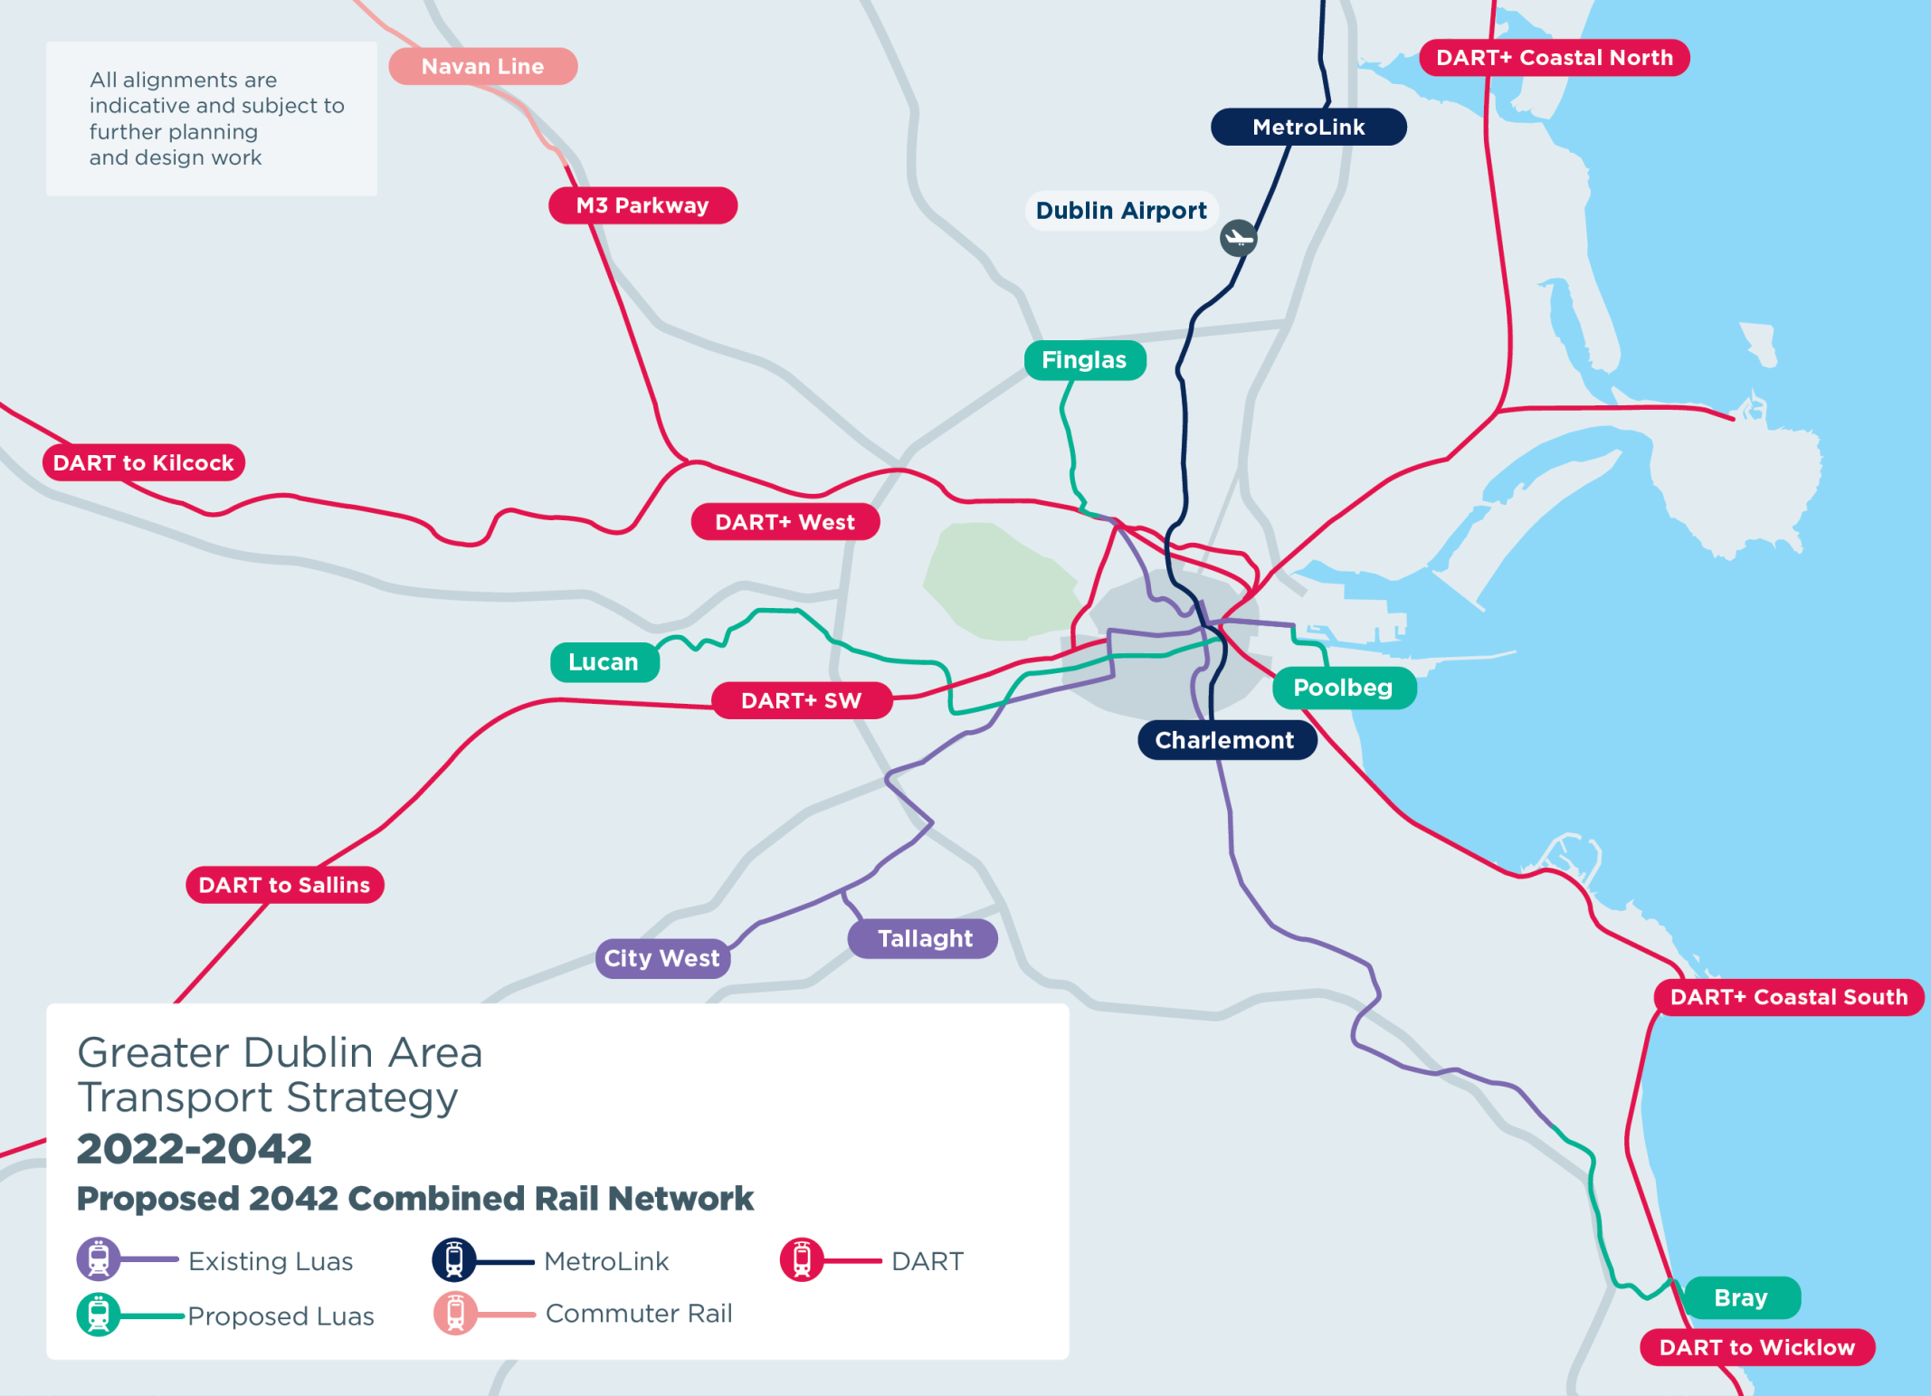

Slide 20
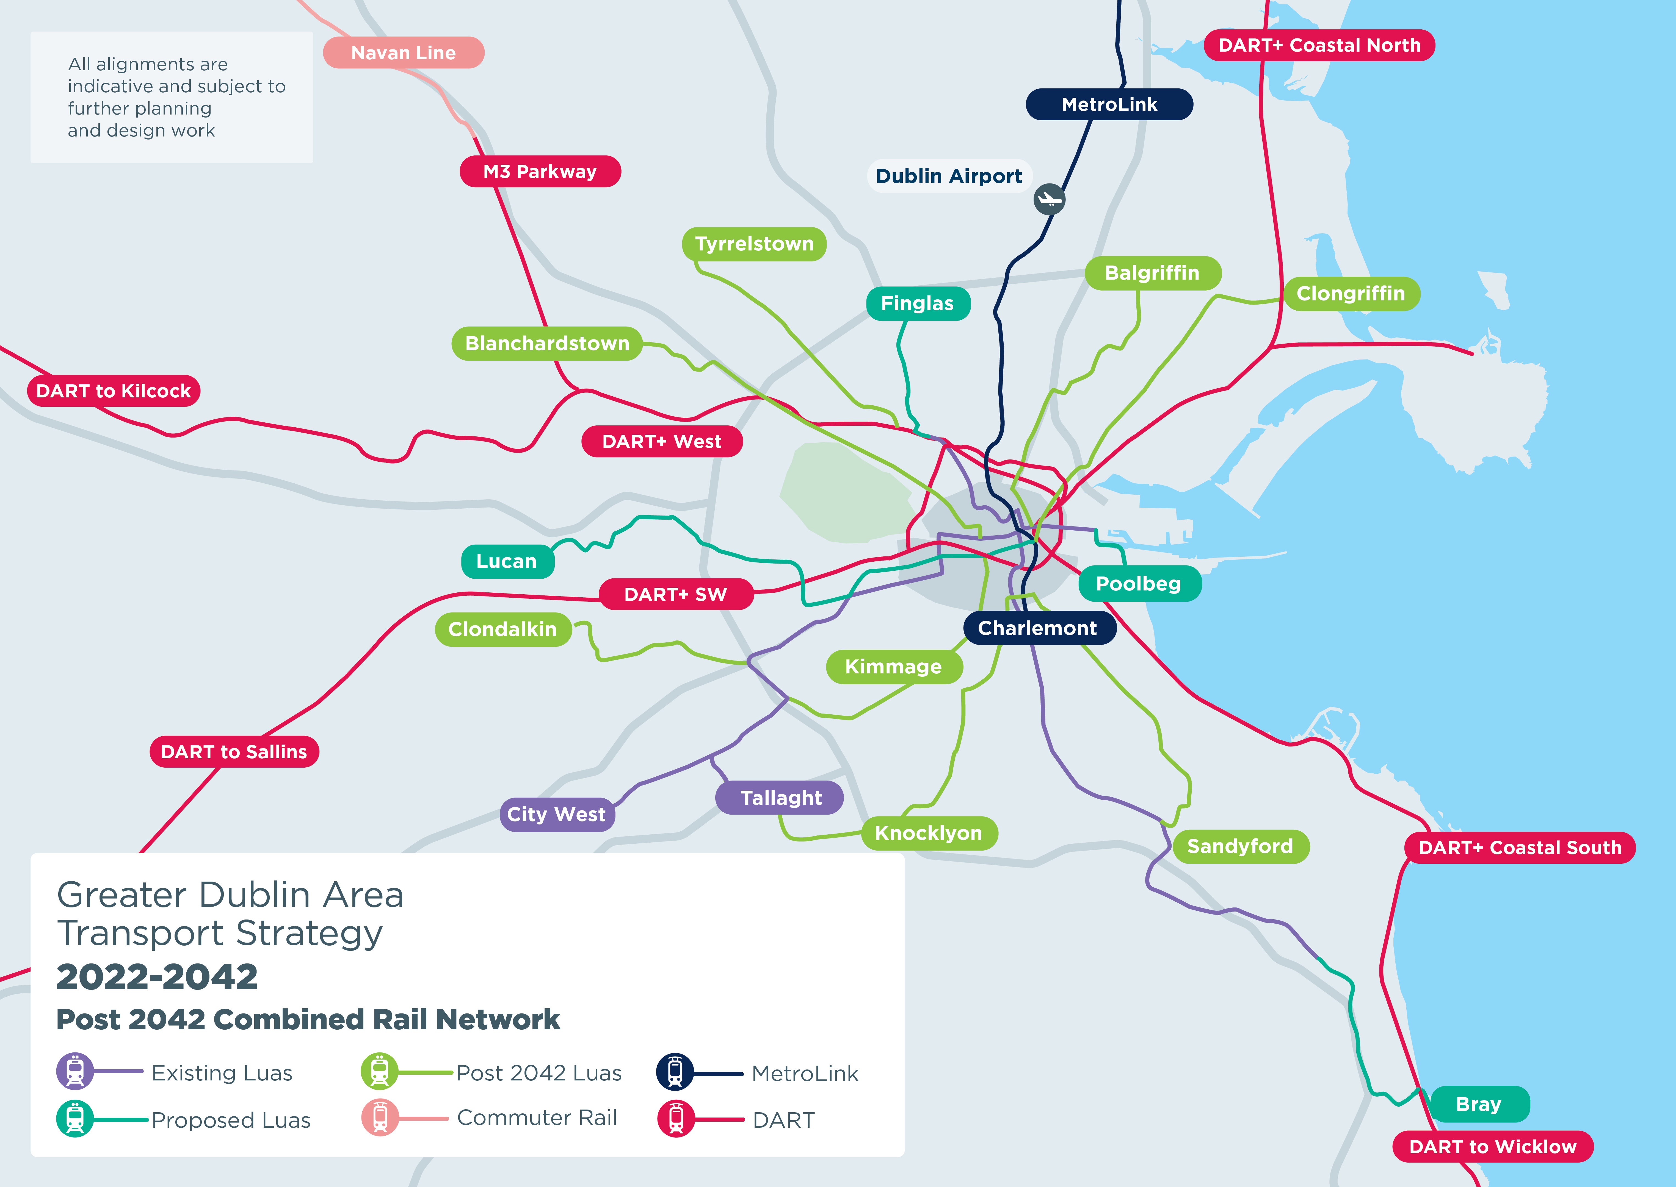

Slide 21
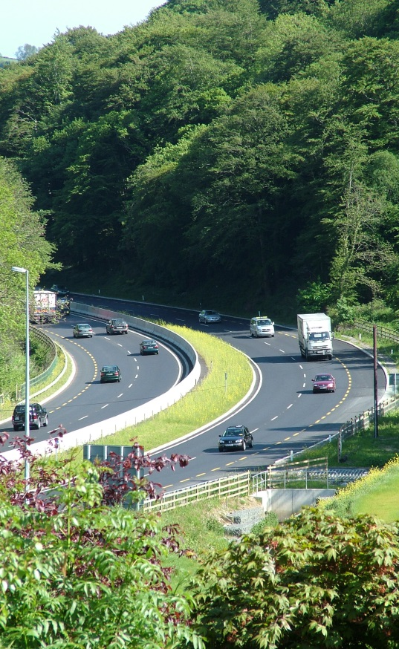
Roads
Draft Strategy sets out “Principles of Road Development” including:
There will be no significant increase in capacity for private car trips on radial roads within the Metropolitan Area, except where re-alignments or junction changes are necessary for safety reasons
That road schemes will be designed to provide safe and appropriate arrangement to facilitate walking, cycling and public transport provision
That where a road scheme comprises an urban bypass, measures must be proposed and implemented to reallocate road space within the bypassed area to sustainable transport and/or public realm improvements

Slide 22
Roads
Various National Road schemes are included for implementation, incorporating bus priority where appropriate:
N2 Upgrade including Slane Bypass
M3/N3 between Junction 1 and Junction 4
N7 from Naas to M50 to remove uncontrolled direct accesses
N/M11 Upgrade including bus priority
N81 including bus priority
The Eastern Bypass is not proceeding but a South Port Access Route which will link from the national road network at the Dublin Tunnel to serve the south port lands and adjoining areas is included
An appropriate road link between the N3 and N4 national roads, which can provide a satisfactory alternative in the event of issues arising on the M50 between Junctions 6 and 7 is proposed
Provision for necessary regional and local road development is included, with an emphasis on designing for sustainable transport
A place based approach to urban roads and streets is strongly supported

Slide 23
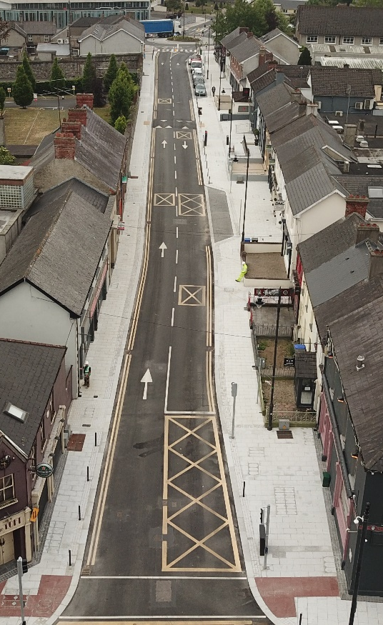
Traffic Management and Travel Options
The infrastructure and services proposals set out in the Draft Transport Strategy must be augmented by measures that seek that prioritises sustainable transport movement and manages the manner in which traffic can move around the region. These addresss:
Management of Dublin City Centre
Management of Urban Centres
Reduced Speed Limits
Variable Speed Limits
Low-Traffic Neighbourhoods
Car-Free Zones
Home Zones
Safe Routes to School
Car Sharing
Car-free Residential Development
Car Parking Standards
Reduction in Public Sector Parking in City Centre
Electric Vehicles
Motorcycles and Mopeds
Motorcycle Parking
Connected and Autonomous Vehicles

Slide 24
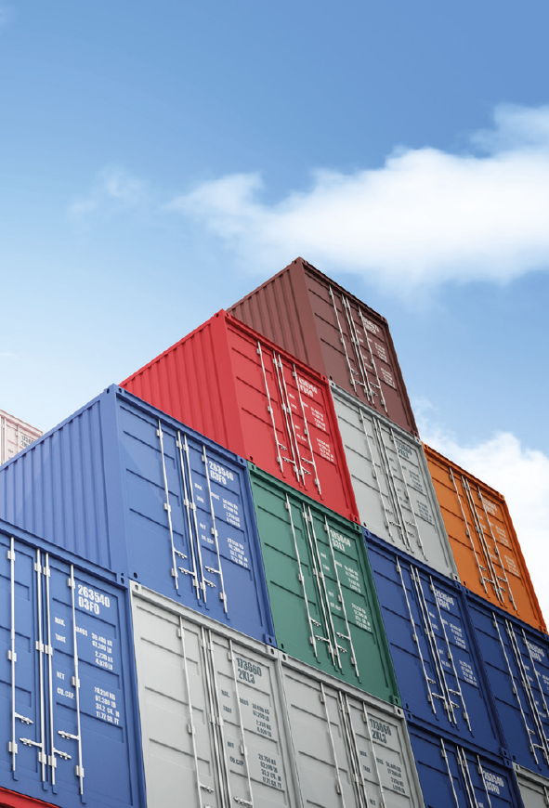
Freight
Efficient goods movement is essential for the economic viability of the region. The Draft Strategy sets out a number of measures in this regard.
Preparation of a Strategy for Sustainable Freight Distribution for the Greater Dublin Area
Identifying appropriate locations for freight-intensive developments for inclusion in local authority Development Plans
Identifying specific HGV routes and/or time restrictions for deliveries, to improve efficiency while minimising the impact of HGV movements
Implementing the outcomes of the Rail Freight 2040 Strategy
Implementing measures to reduce the environmental impact of the freight sector

Slide 25
Climate Action Management
The Climate Action Plan and Low Carbon Development (Amendment) Act 2021 requires a total reduction of 51% in CO₂ emissions over the period to 2030, relative to a baseline of 2018
We need to increase the proportion of travel by sustainable modes and reduce the level of usage of petrol/diesel powered vehicles
Additional demand management measures will need to be put in place to complement the additional transport provision set out in the Strategy in order to achieve the overall 51% reduction goal
The NTA will undertake a detailed assessment to establish the optimal framework of demand management measures, which is likely to include parking restraint, zonal charging, additional tolling / road pricing and/or further vehicle electrification
Implementation of the full measures set out in this strategy aim to reduce greenhouse gas emissions in the GDA to below 1 Mt CO₂ eq by 2042 (from a 2018 level of 3.2 Mt CO2 eq)

Slide 26
Strategy Outcomes

Slide 27
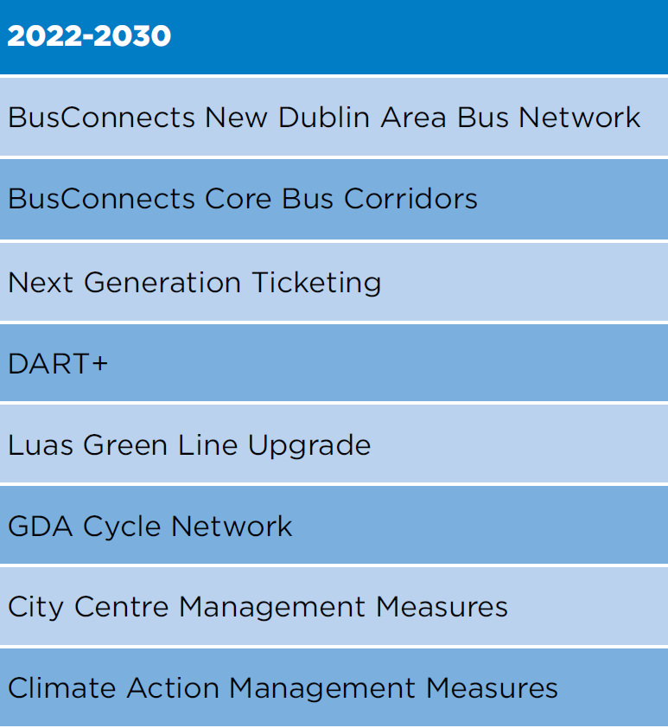
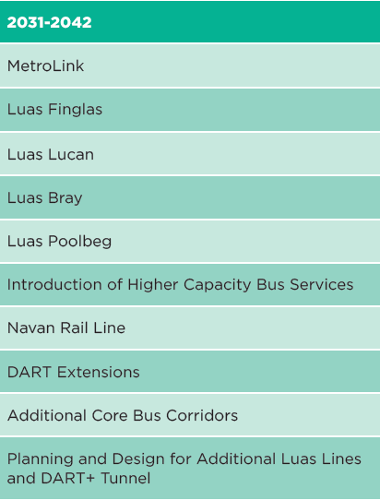
Cost and Indicative Delivery Programme
The overall capital cost of the proposals set out in the Draft Transport Strategy is in the order of €25 billion in current prices

Slide 28
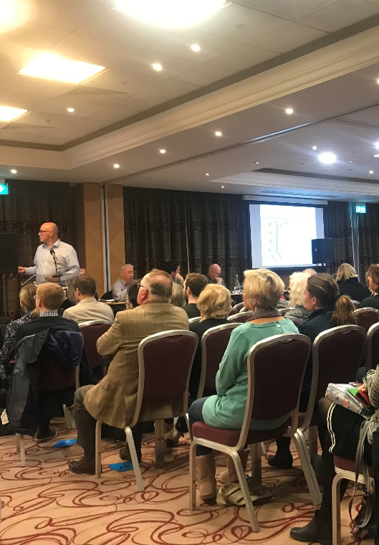
Public Consultation Process
Public consultation runs to Friday 17th December
Draft Strategy document + 24 supporting technical reports all available at www.nationaltransport.ie
Submissions can be made via the online feedback form available at www.nationaltransport.ie
6 public information webinars to be held – Tuesdays and Thursdays
16th Nov @ 1.00 pm 18th Nov @ 6.30 pm
23rd Nov @ 6.30 pm 25th Nov @ 1.00 pm
2nd Dec @ 1.00 pm 7th Dec @ 6:30pm

Slide 30
https://youtu.be/IqpoaJIvSzk

