Slide 1






















FULL COLOUR ICONS
walking
bike
bus
taxi
tram
train
freight
private car
TFI local link
bike hire
cycling time
walking time
ferry
airplane/airport
clamping
smart card
contact-less
maps
information
journey planner
fares
timetables

Slide 2






















SLATE COLOUR ICONS
walking
bike
bus
taxi
tram
train
freight
private car
TFI local link
bike hire
cycling time
walking time
ferry
airplane/airport
airplane/airport
smart card
contact-less
maps
information
journey planner
fares
timetables

Slide 3





OPERATORS

Slide 4







Slide 5


DART PLUS LOGO SUITE – for more DART+ logos click here

Slide 6






Slide 7








TFI APPS
TFI Go
Leap top-up
TFI Live
Driver Check
Government/ EU Logos

Slide 8
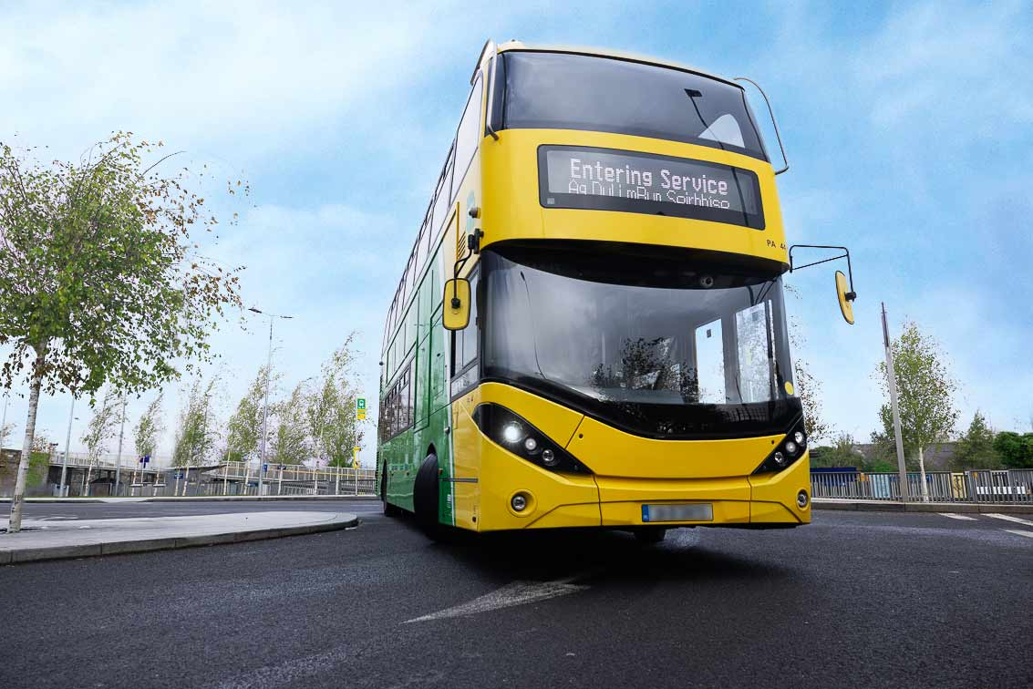
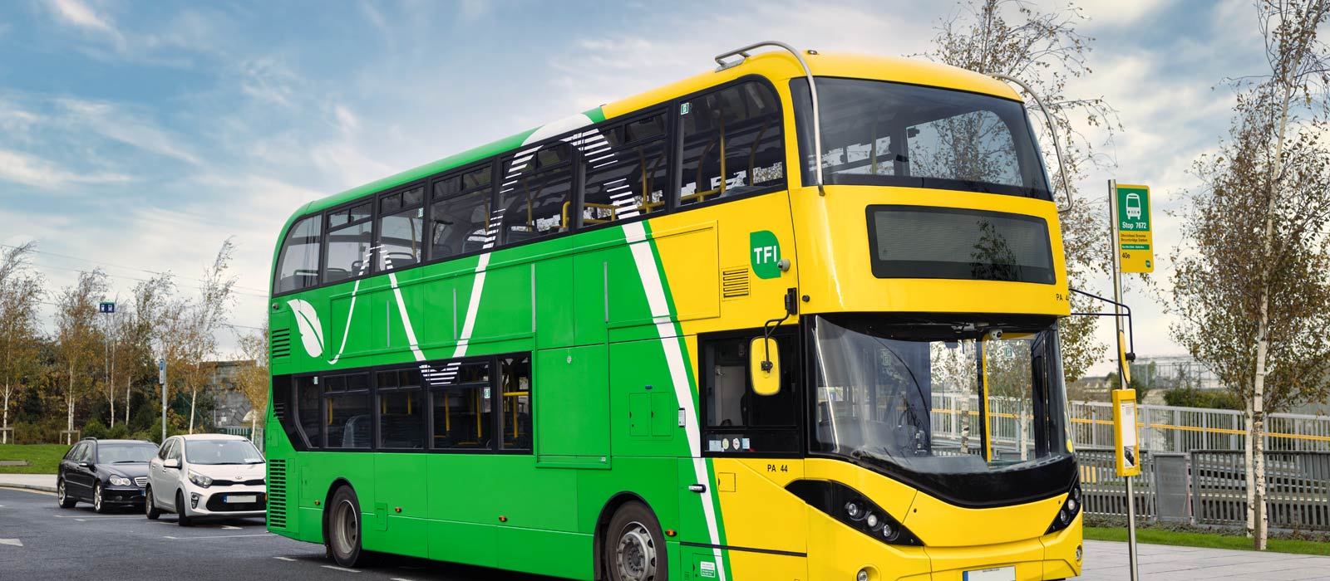
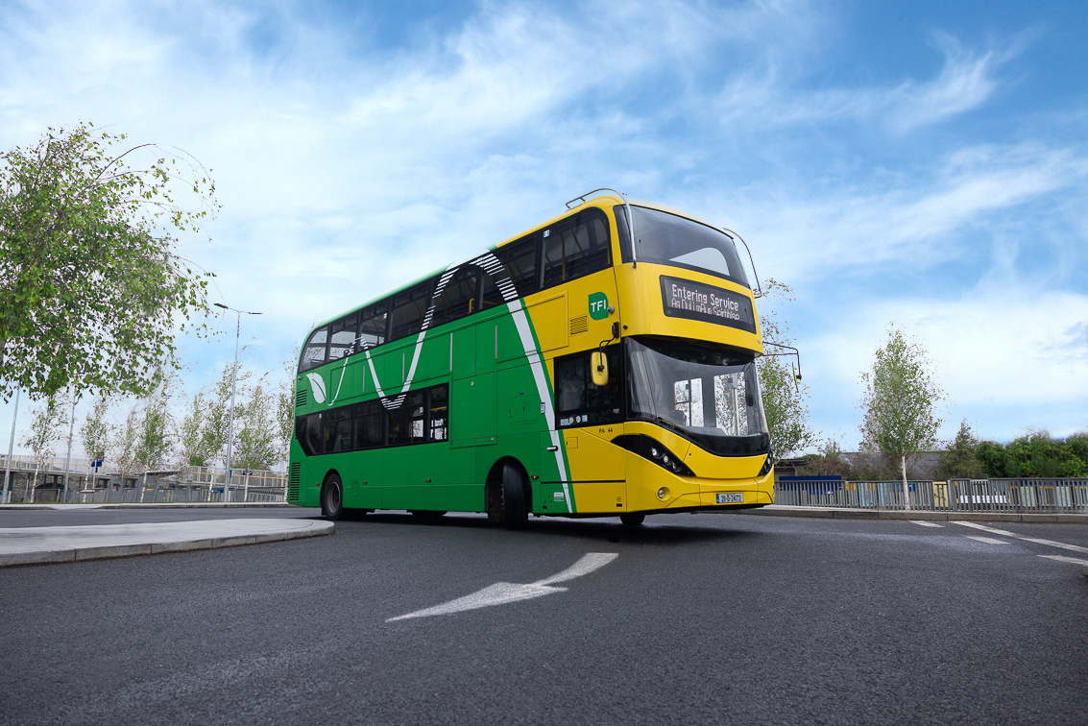
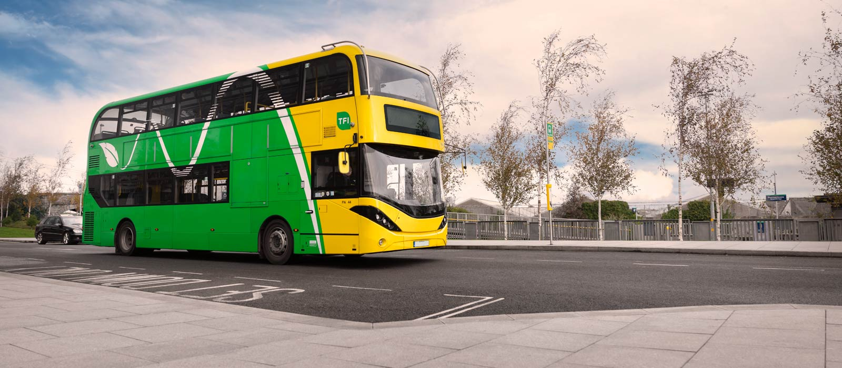
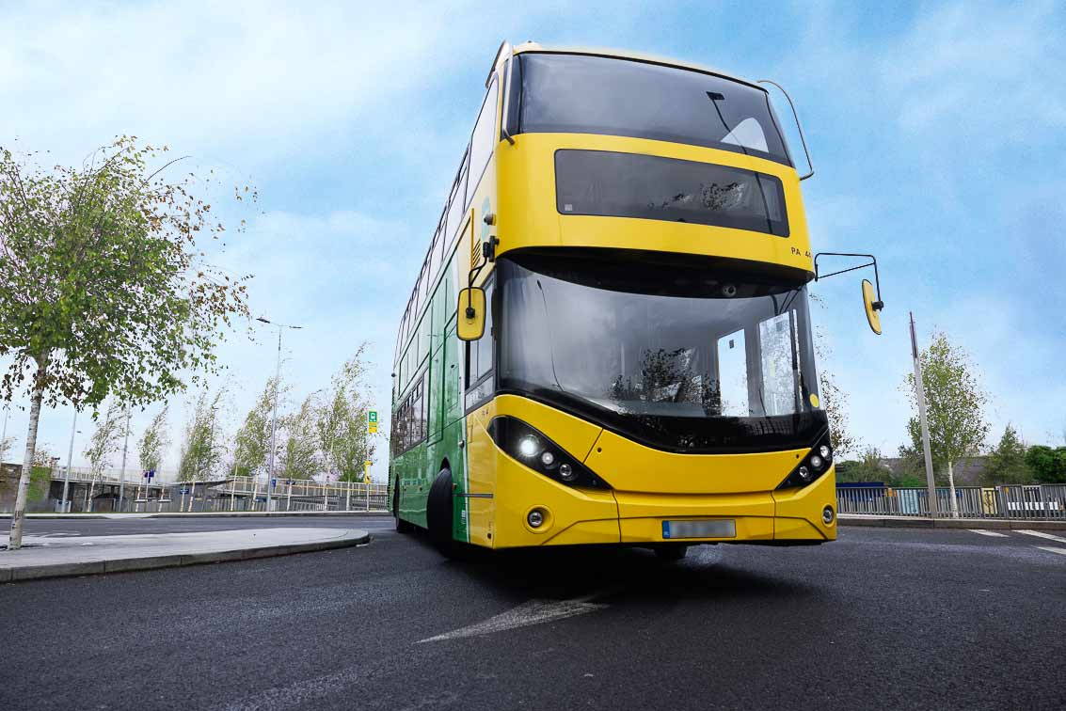
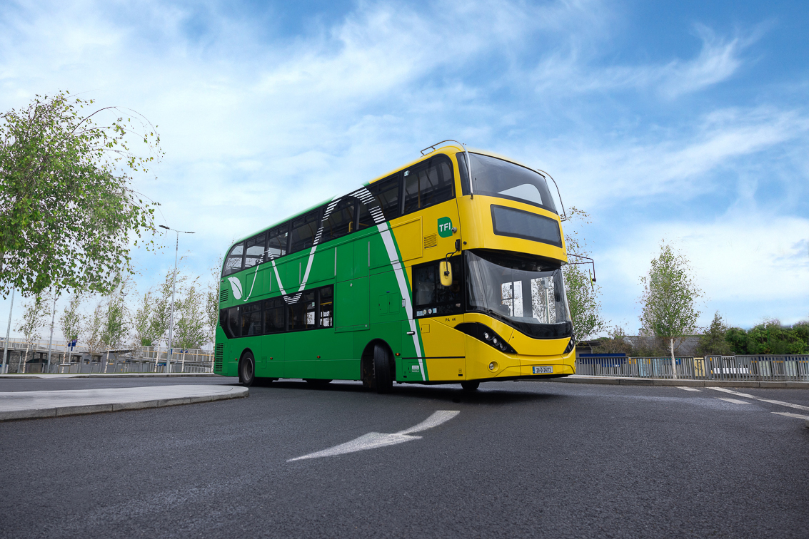
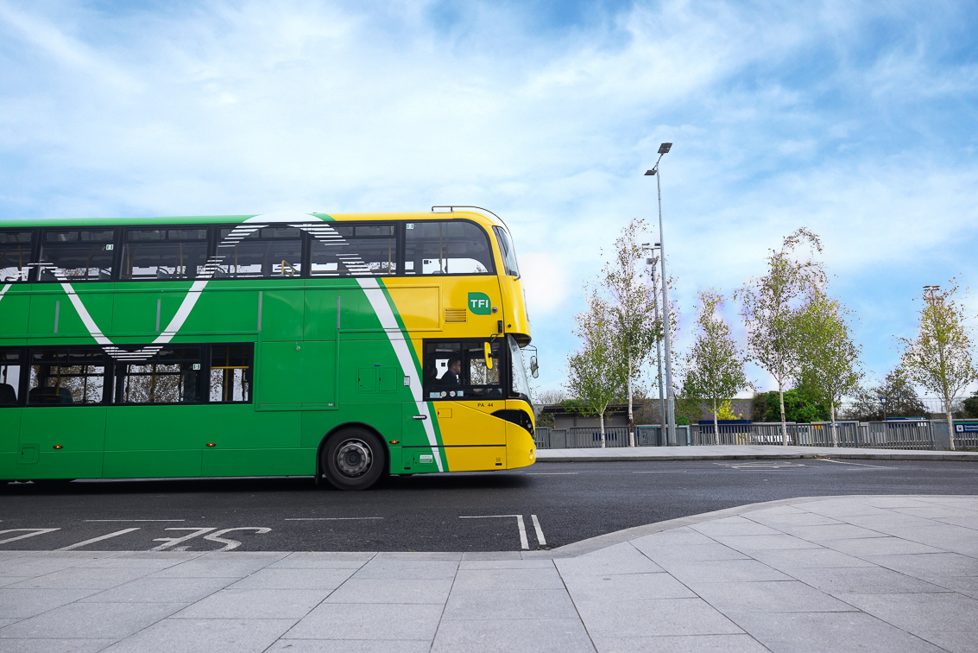

Slide 9
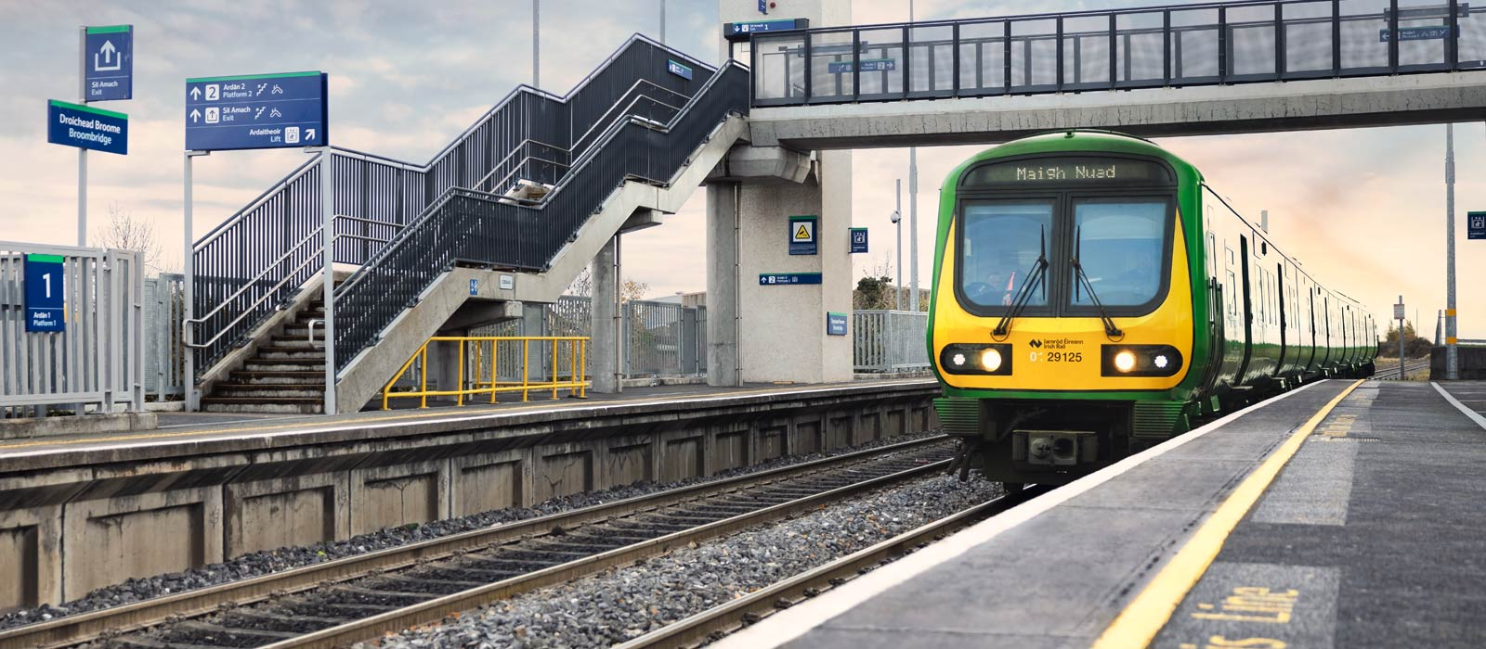
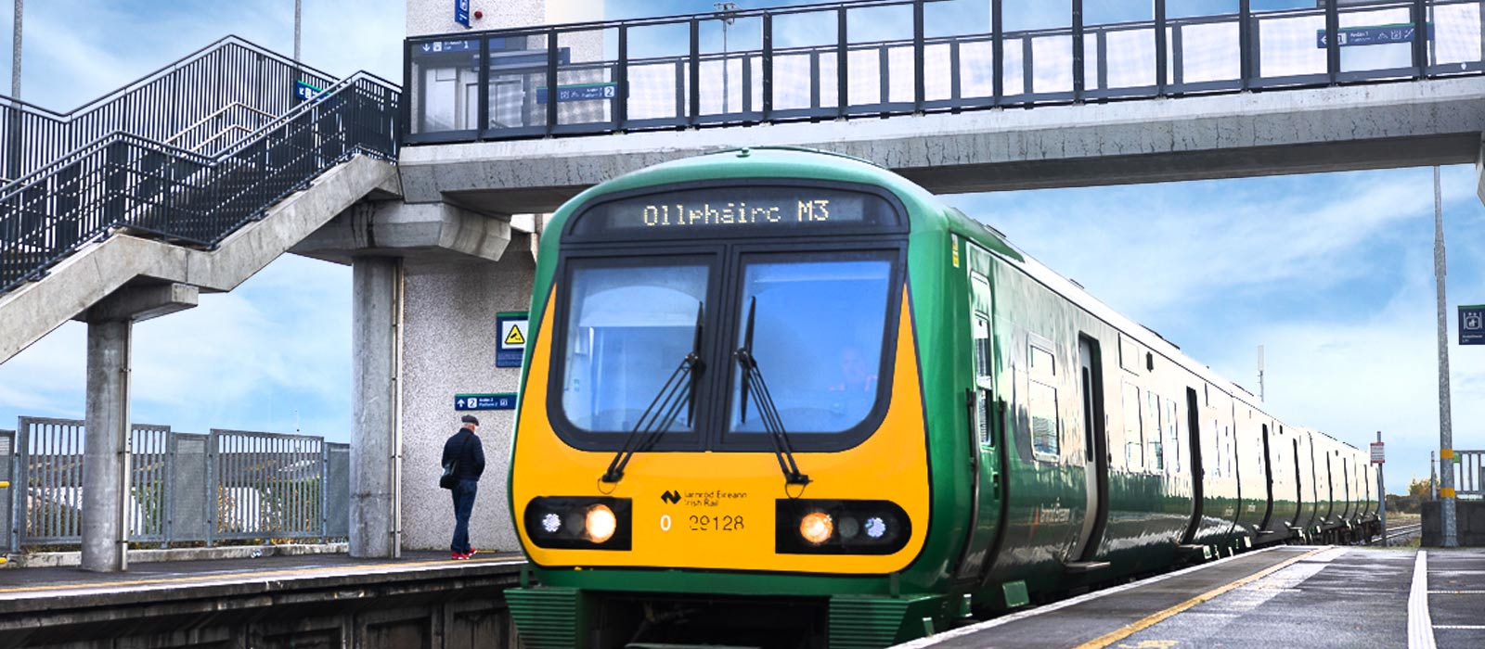
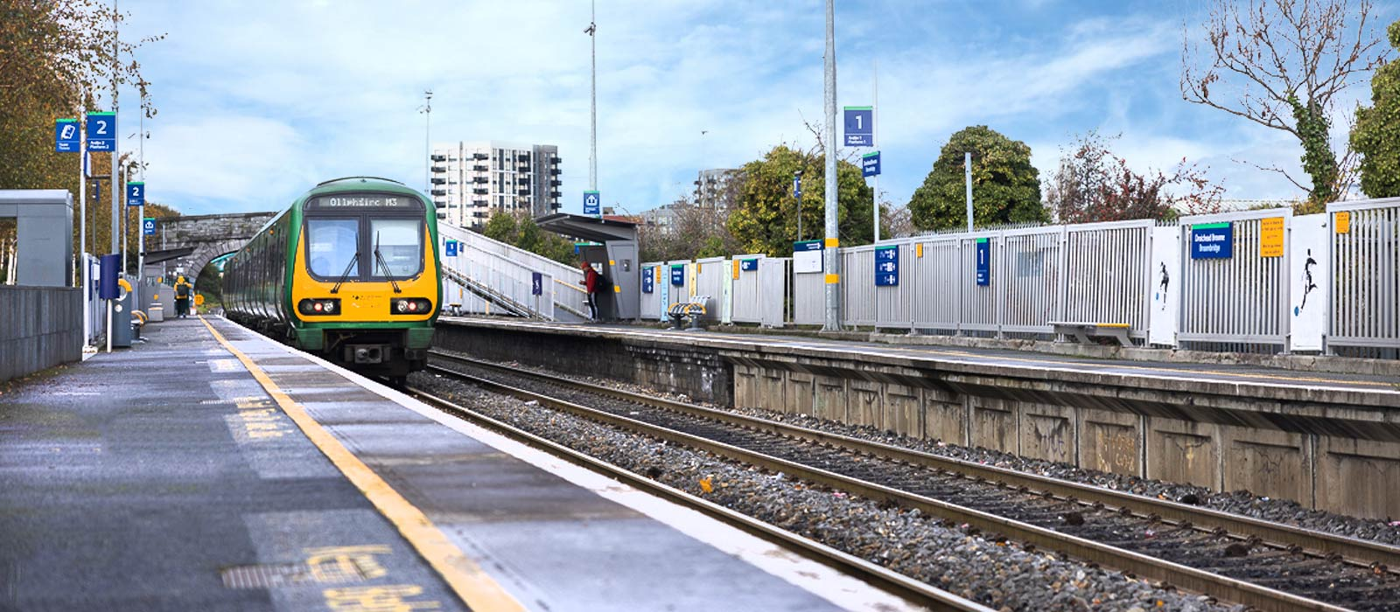
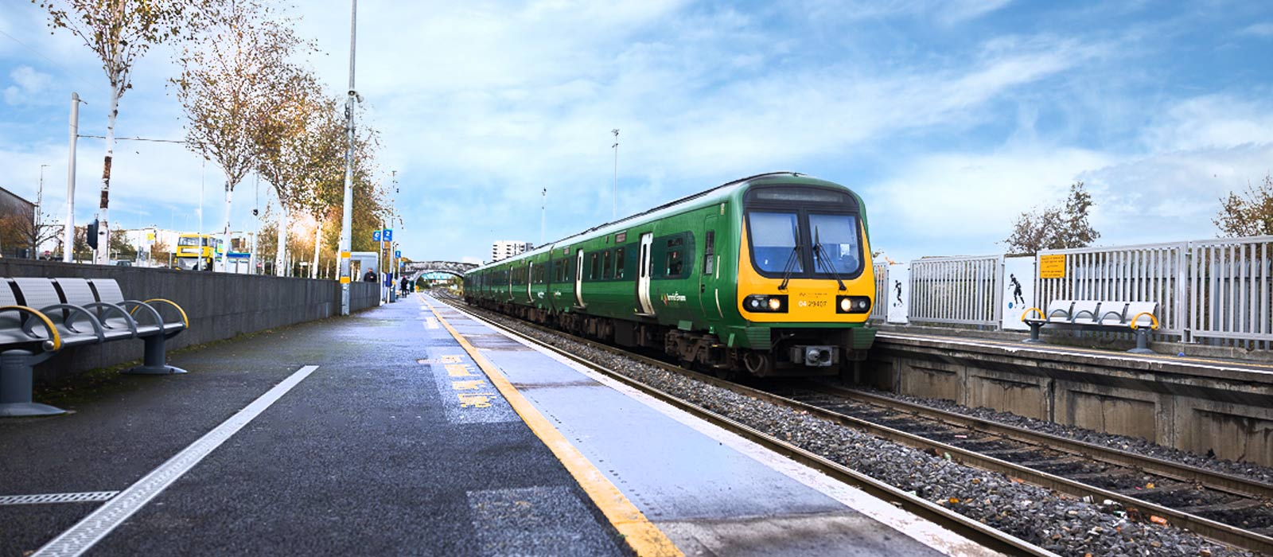
IMAGE BANK- TRAIN

Slide 10
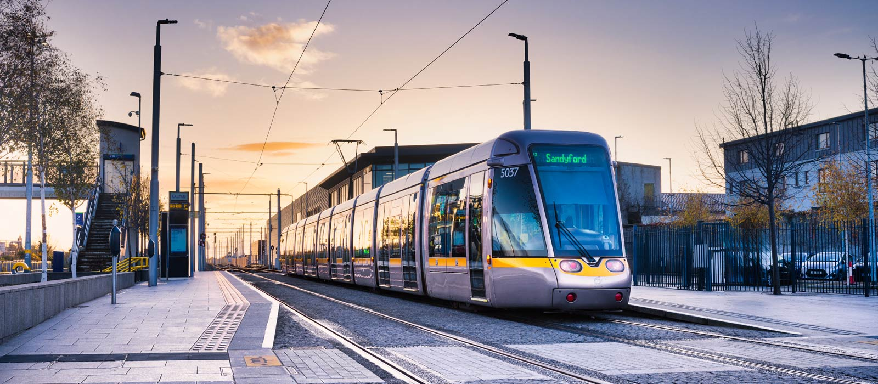
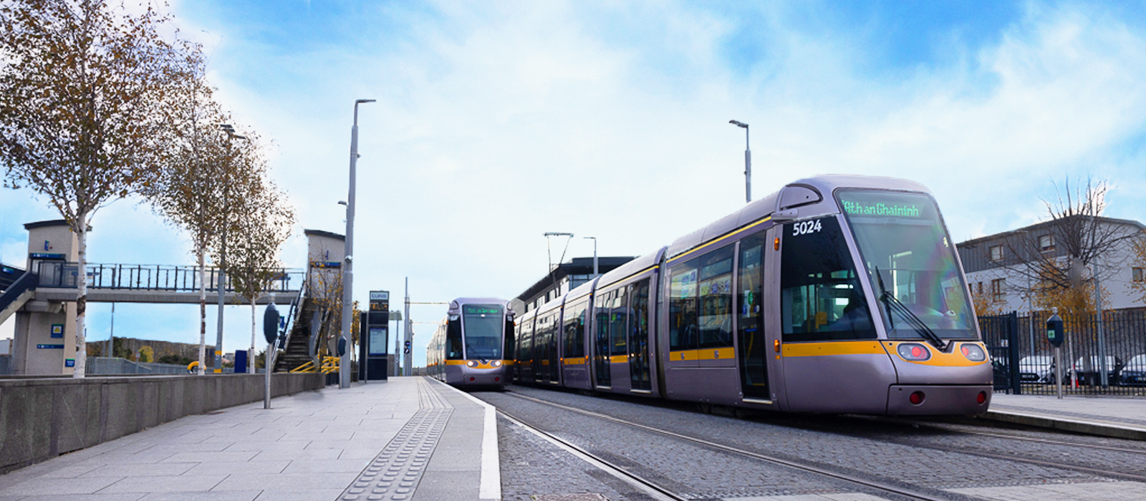
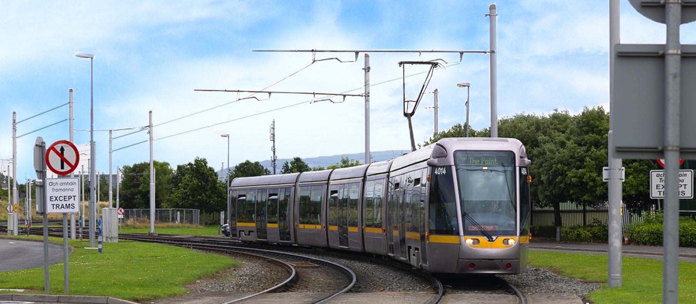
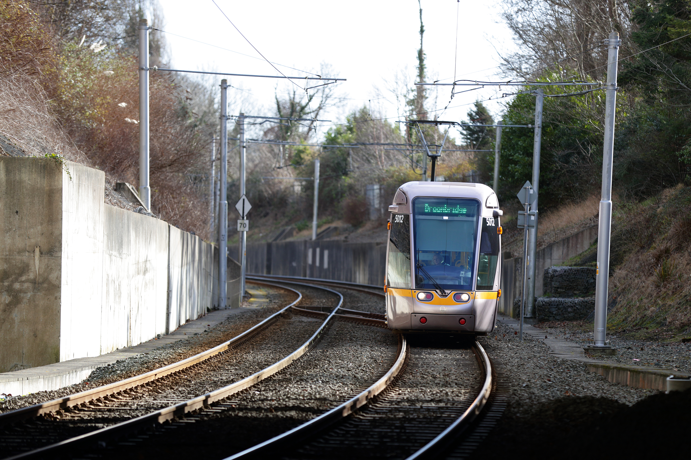
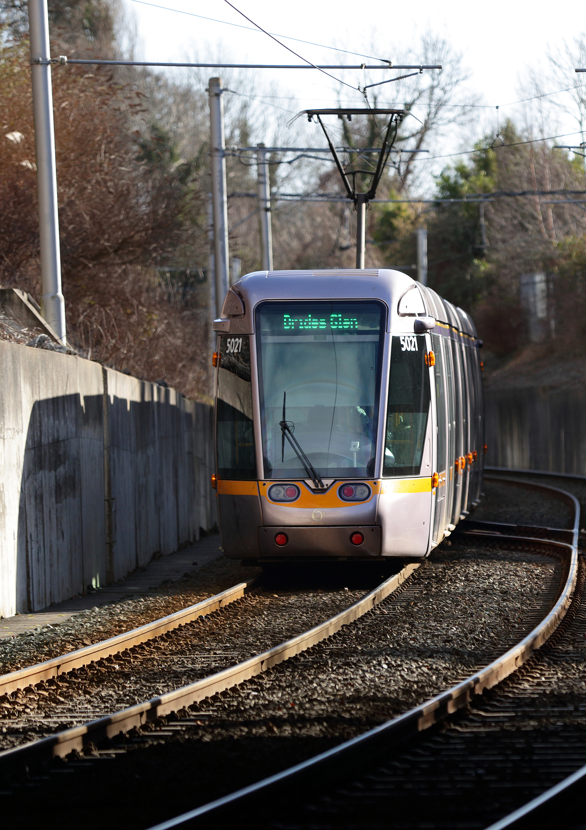
IMAGE BANK- TRAM

Slide 11




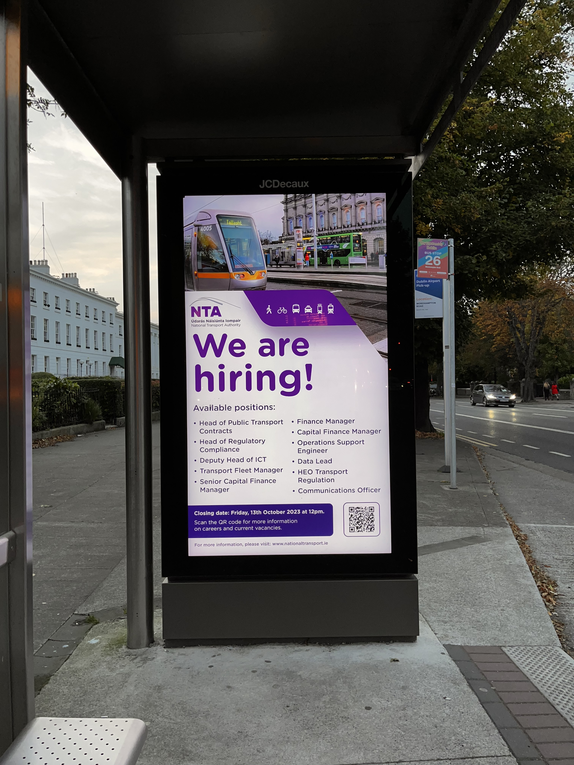
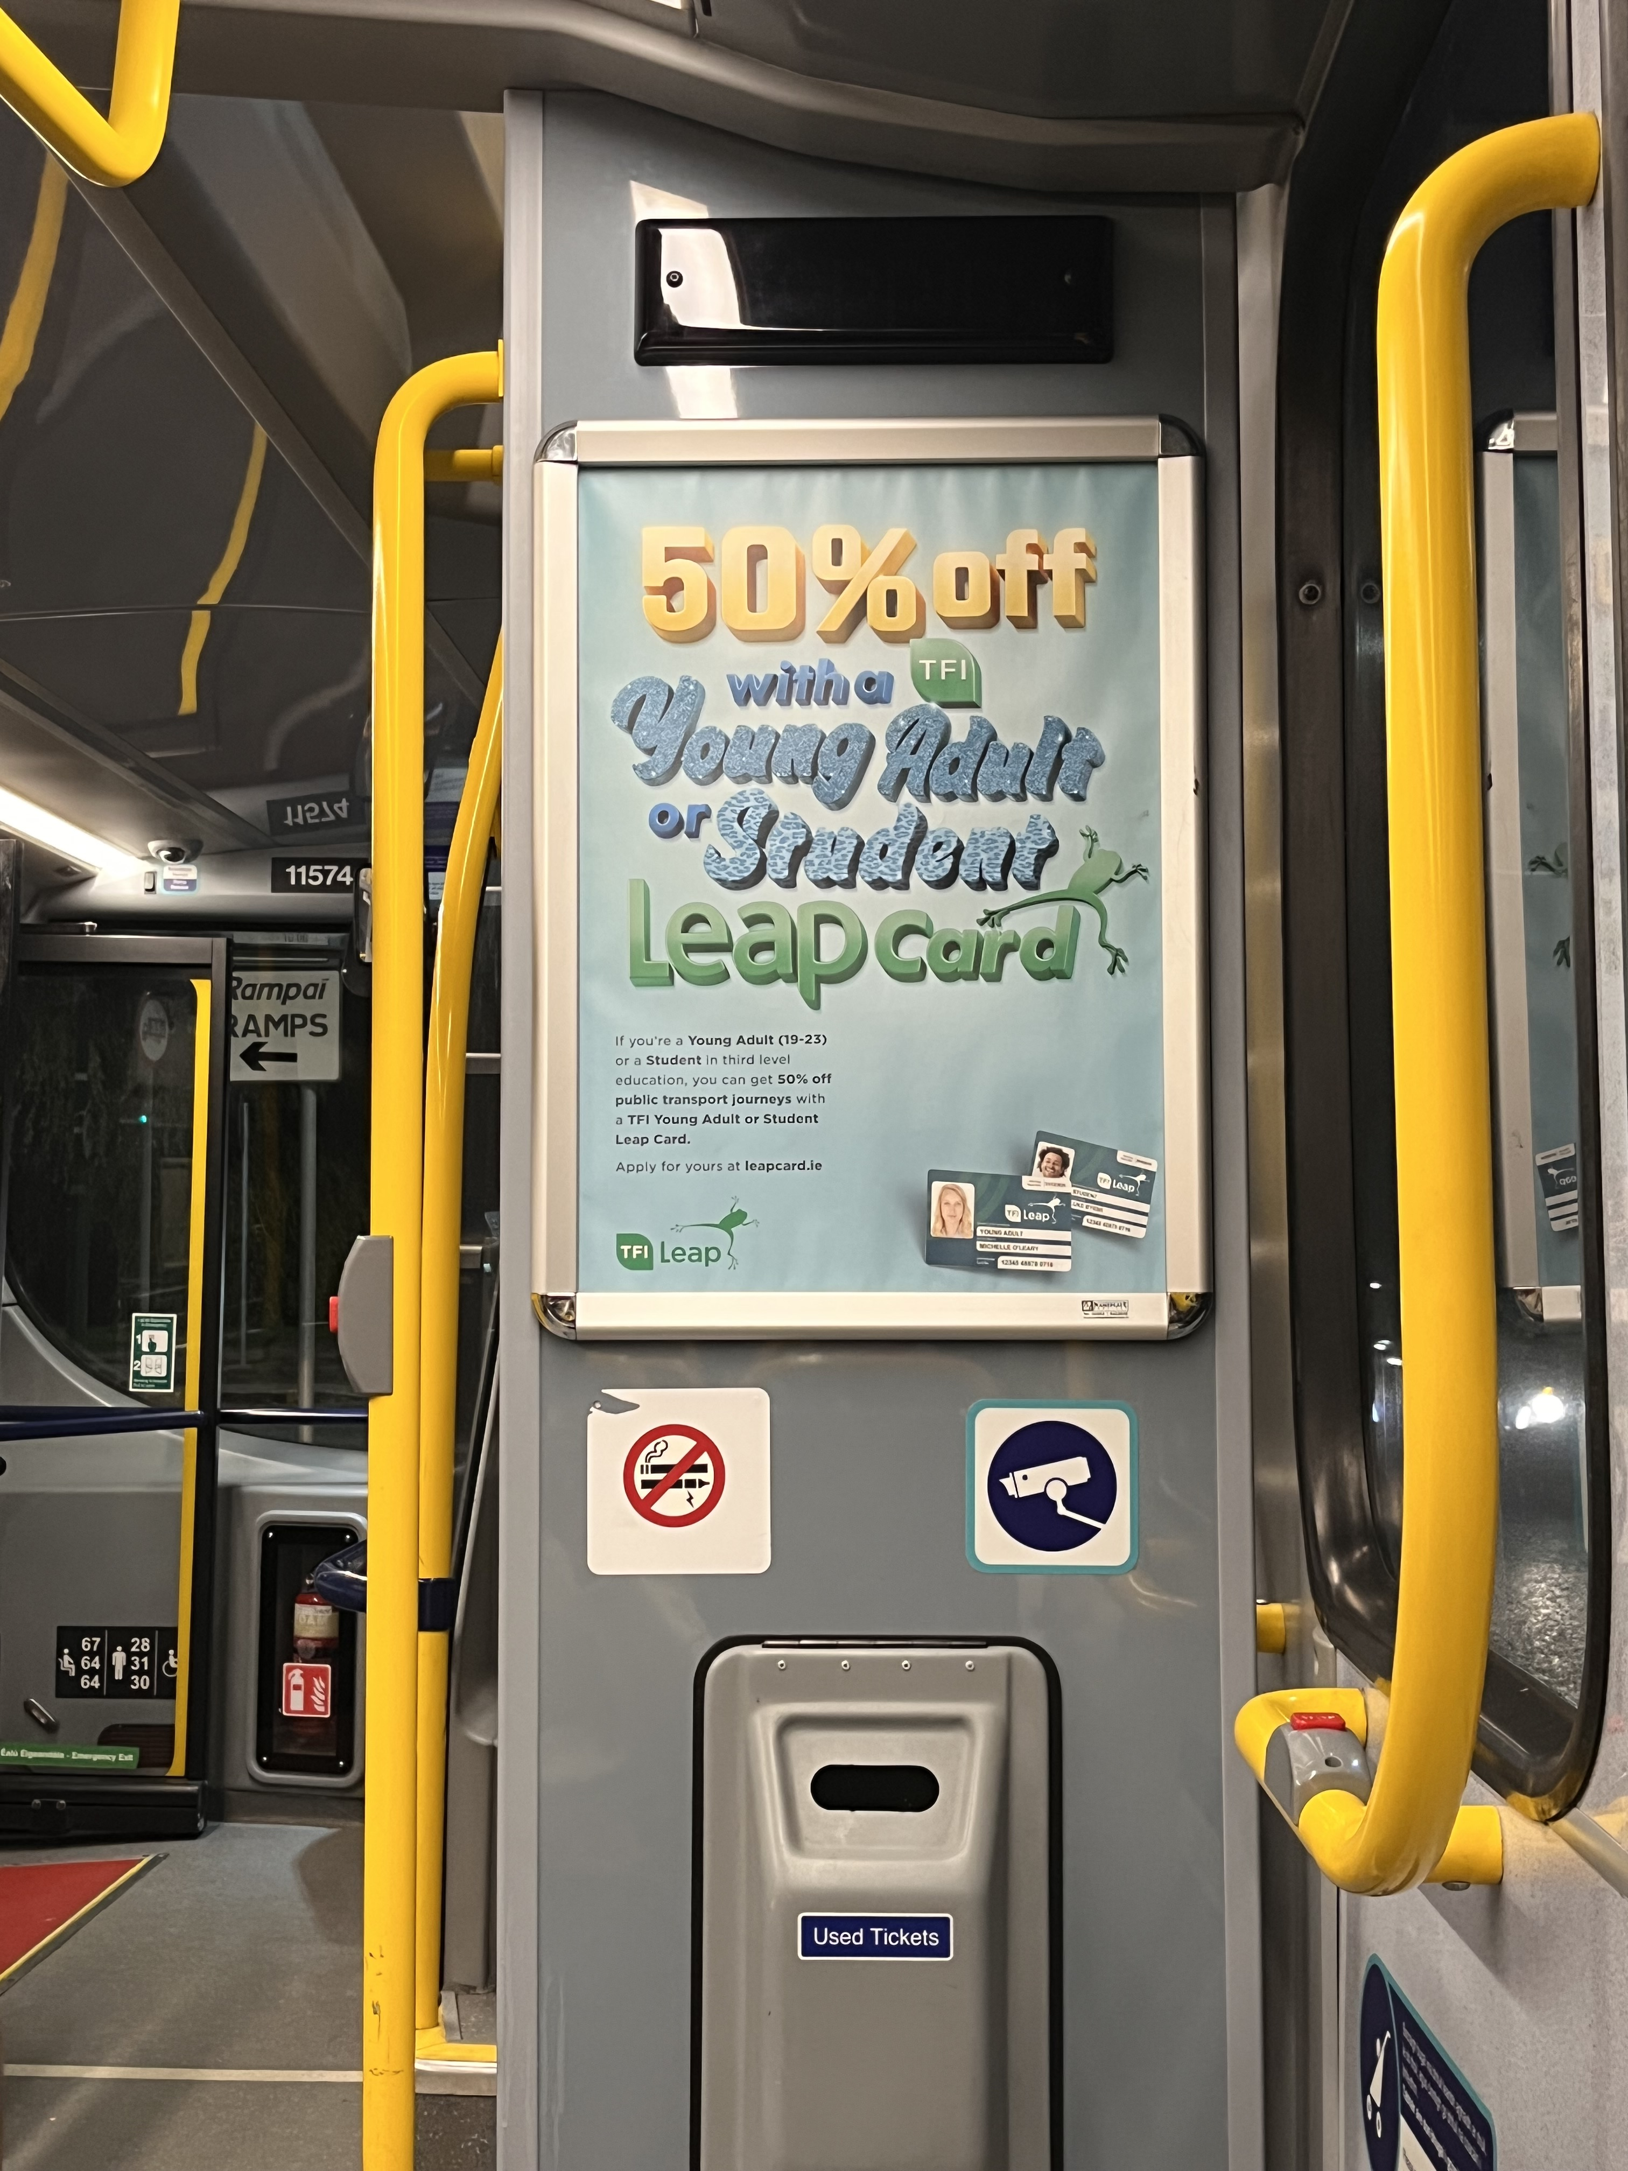
MOCK-UPS
Standard pull-up
laptop
desktop
Smart-phone
bus-shelter
On-board A3

